Slide 1
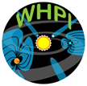
Comparative Solar Minima using the McIntosh Archive
Ian M. Hewins, Sarah E. Gibson, David F. Webb, Robert H. McFadden,
Thomas A. Kuchar, Barbara A. Emery

Slide 2
What is the McIntosh Archive?

Slide 3
What is the McIntosh Archive?
The McIntosh Archive consists of four solar cycles (SC20 - 23) of synoptic maps of solar features (magnetic polarities, coronal holes, filaments, sunspots and plage) that were produced by Patrick McIntosh and his cartographers.

Slide 4
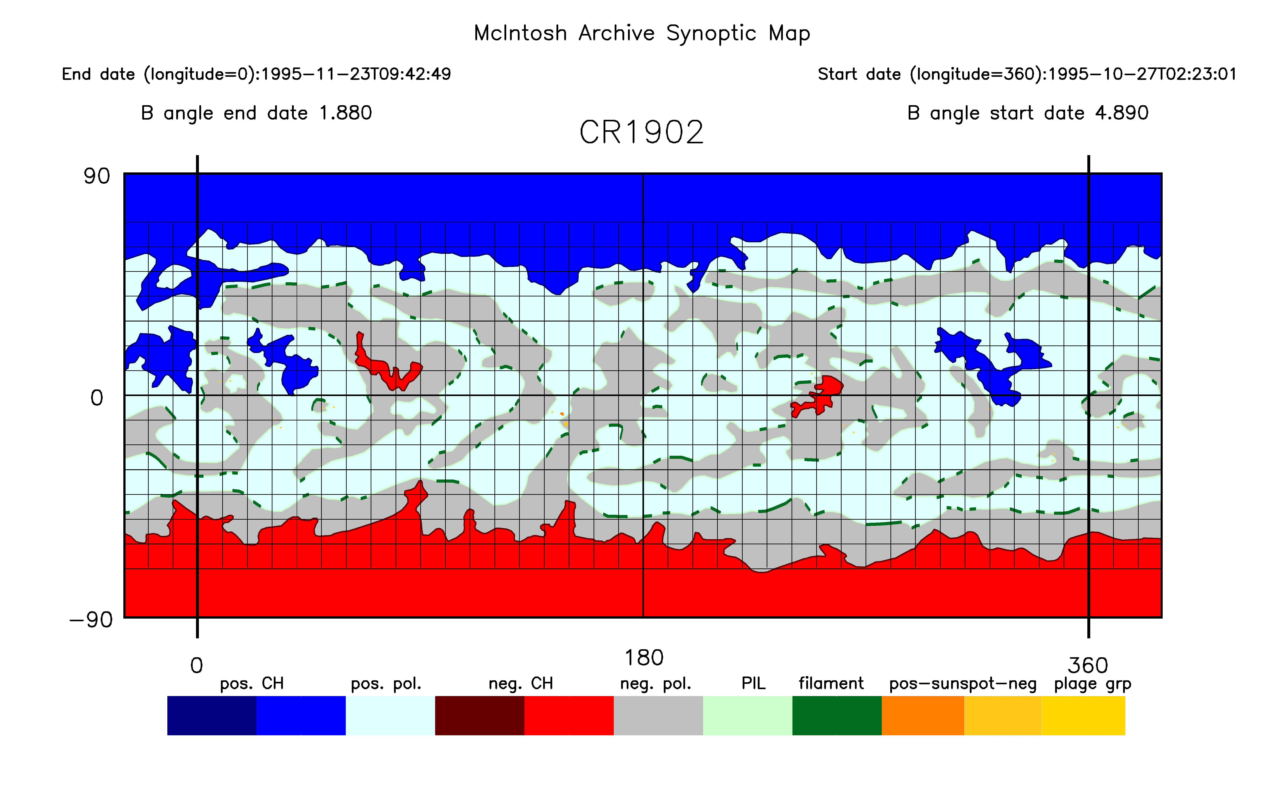
What is the McIntosh Archive?
The McIntosh Archive consists of four solar cycles (SC20 - 23) of synoptic maps of solar features (magnetic polarities, coronal holes, filaments, sunspots and plage) that were produced by Patrick McIntosh and his cartographers.
CR1902-
Oct. 1995
Solar minimum
SC22-23

Slide 5
What is the McIntosh Archive?
The McIntosh Archive consists of four solar cycles (SC20 - 23) of synoptic maps of solar features (magnetic polarities, coronal holes, filaments, sunspots and plage) that were produced by Patrick McIntosh and his cartographers.
CR1902-
Oct. 1995
Solar minimum
SC22-23
We are continuing McIntosh’s work by producing maps for SC24 using Extreme Ultraviolet (EUV) data instead of He 10830 Å. The NASA Solar and Heliospheric Observatory (SOHO) as well as their Solar Dynamics Observatory (SDO) were used.

Slide 6
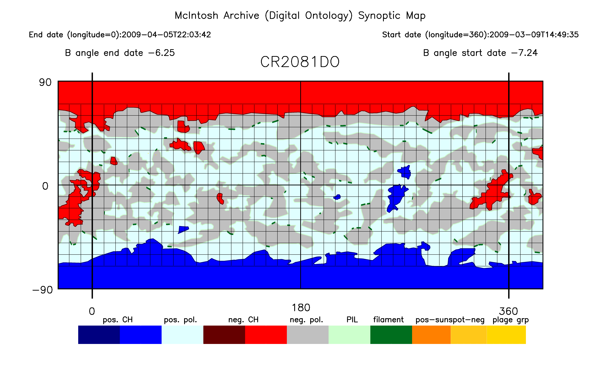
What is the McIntosh Archive?
The McIntosh Archive consists of four solar cycles (SC20 - 23) of synoptic maps of solar features (magnetic polarities, coronal holes, filaments, sunspots and plage) that were produced by Patrick McIntosh and his cartographers.
CR1902-
Oct. 1995
Solar minimum
SC22-23
We are continuing McIntosh’s work by producing maps for SC24 using Extreme Ultraviolet (EUV) data instead of He 10830 Å. The NASA Solar and Heliospheric Observatory (SOHO) as well as their Solar Dynamics Observatory (SDO) were used.
CR2081-
Mar. 2009
Solar
Minimum
SC23-24

Slide 7
Research with the McIntosh Archive
The archive allows long term studies of individual features such as sunspots (right) but also allows us to look at multiple types of features in relation to each other (bottom). It can look at open and closed field structures simultaneously. We can look at the polarity of features and how that plays out in each hemisphere. Or we can look at specific times in each solar cycle, such as the rush to the poles and the polarity flip at the poles that takes place near solar maximum. In this case, of course, we are studying solar minimum.

Slide 8
Whole Heliosphere and Planetary Interactions (WHPI)
Coronal Hole Carrington Maps

Slide 9
Whole Heliosphere and Planetary Interactions (WHPI)
Coronal Hole Carrington Maps
We produced a supplemental set of related maps created for the SC24-25 (yrs. 2019-2020) solar minimum in support of the Whole Heliosphere and Planetary Interactions (WHPI) interval.

Slide 10
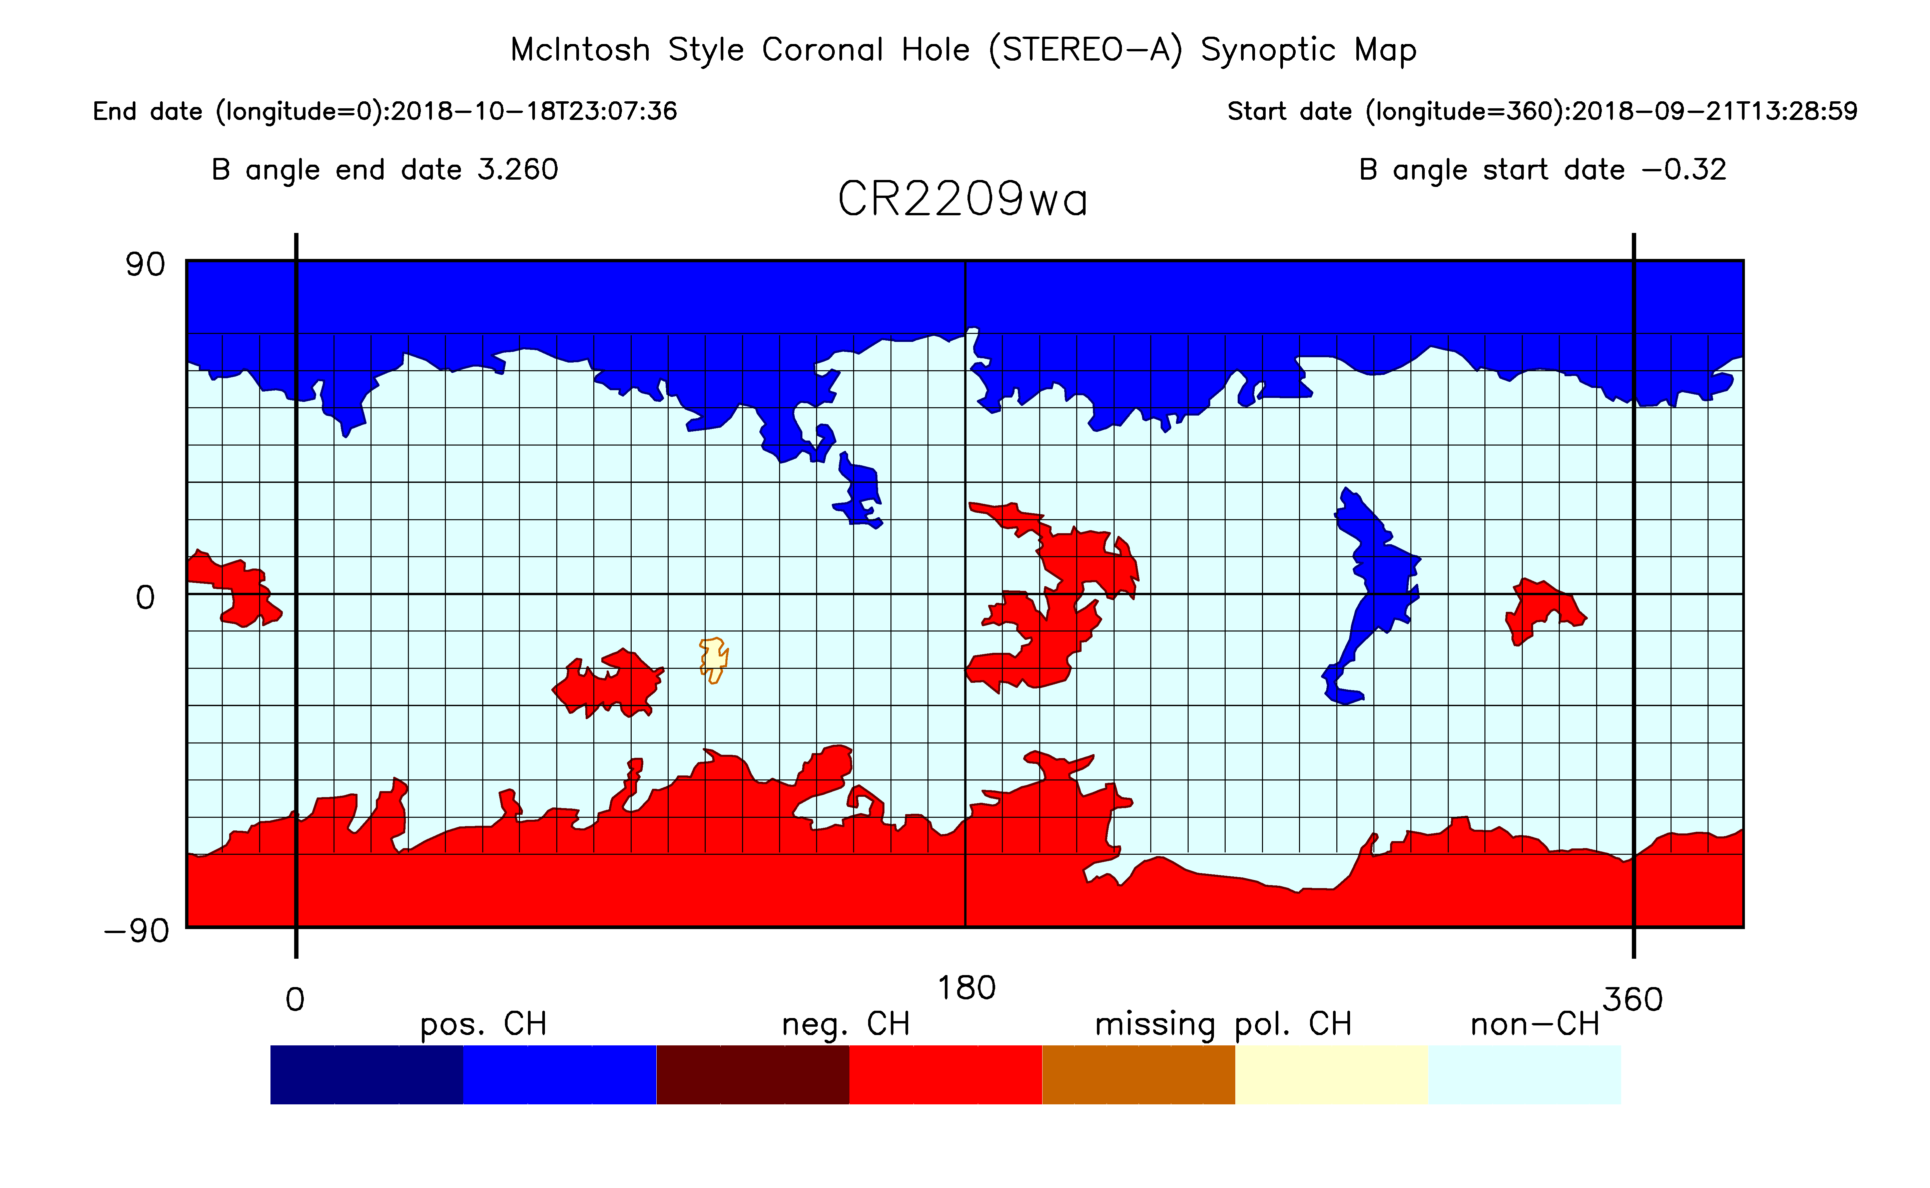
Whole Heliosphere and Planetary Interactions (WHPI)
Coronal Hole Carrington Maps
We produced a supplemental set of related maps created for the SC24-25 (yrs. 2019-2020) solar minimum in support of the Whole Heliosphere and Planetary Interactions (WHPI) project.
CR2209 – Stereo A – EUVI 195

Slide 11
Whole Heliosphere and Planetary Interactions (WHPI)
Coronal Hole Carrington Maps
We produced a supplemental set of related maps created for the SC24-25 (yrs. 2019-2020) solar minimum in support of the Whole Heliosphere and Planetary Interactions (WHPI) interval.
CR2209 – Stereo A – EUVI 195
For each CR 2 coronal hole maps were produced. One with data from Solar Terrestrial Relations Observatory (Stereo A) and one with data from SDO. Polarity determined with SDO magnetograms

Slide 12
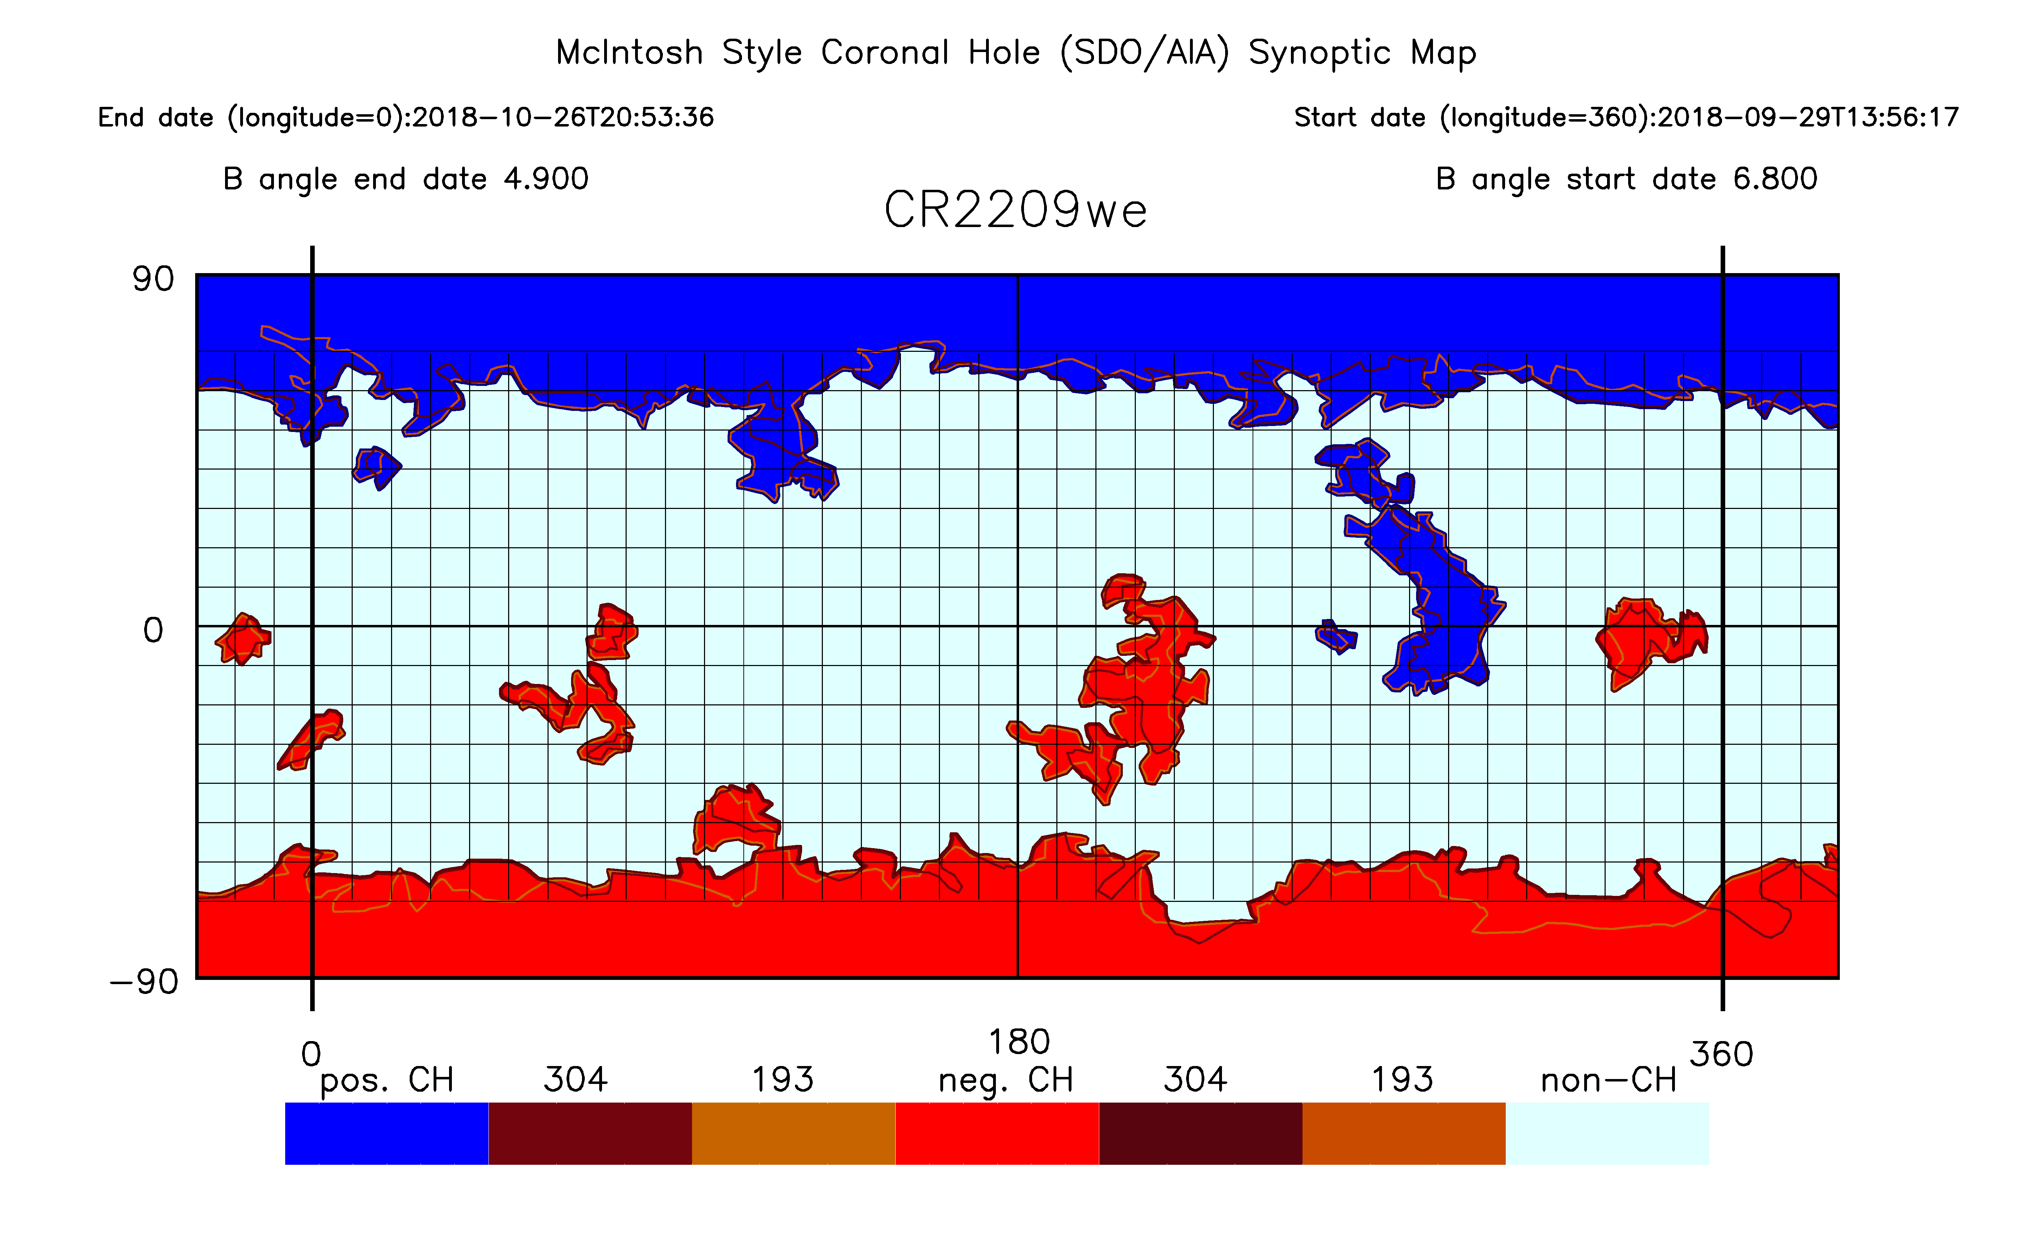
Whole Heliosphere and Planetary Interactions (WHPI)
Coronal Hole Carrington Maps
We produced a supplemental set of related maps created for the SC24-25 (yrs. 2019-2020) solar minimum in support of the Whole Heliosphere and Planetary Interactions (WHPI) interval.
CR2209 – Stereo A – EUVI 195
For each CR 2 coronal hole maps were produced. One with data from Solar Terrestrial Relations Observatory (Stereo A) and one with data from SDO. Polarity determined with SDO magnetograms.
CR2209 –
SDO – AIA 193 and 304

Slide 13
Whole Heliosphere and Planetary Interactions (WHPI)
Coronal Hole Carrington Maps
We produced a supplemental set of related maps created for the SC24-25 (yrs. 2019-2020) solar minimum in support of the Whole Heliosphere and Planetary Interactions (WHPI) interval.
CR2209 – Stereo A – EUVI 195
For each CR 2 coronal hole maps were produced. One with data from Solar Terrestrial Relations Observatory (Stereo A) and one with data from SDO. Polarity determined with SDO magnetograms
CR2209 –
SDO – AIA 193 and 304
Maps were produced for CRs 2209 – 2227 and we are producing maps for Parker Solar Probe perihelia and the April eclipse.

Slide 14
Cross Calibration of HE 10830 Å to Extreme Ultraviolet (EUV)

Slide 15
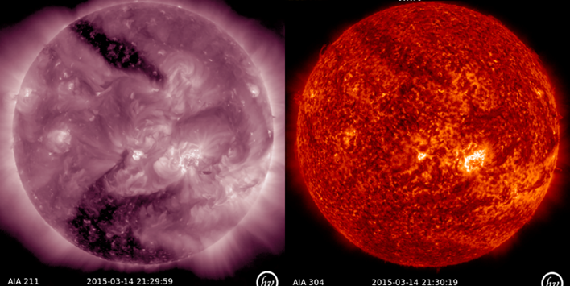
Cross Calibration of HE 10830 Å to Extreme Ultraviolet (EUV)

Slide 16
Cross Calibration of HE 10830 Å to Extreme Ultraviolet (EUV)
Although the historical archive used He-I 10830 Å data for coronal hole boundaries, its collection was phased out and EUV became the accepted standard for coronal hole observation. By 2015 He-I 10830 Å was no longer consistently available to the degree needed to make synoptic maps.

Slide 17
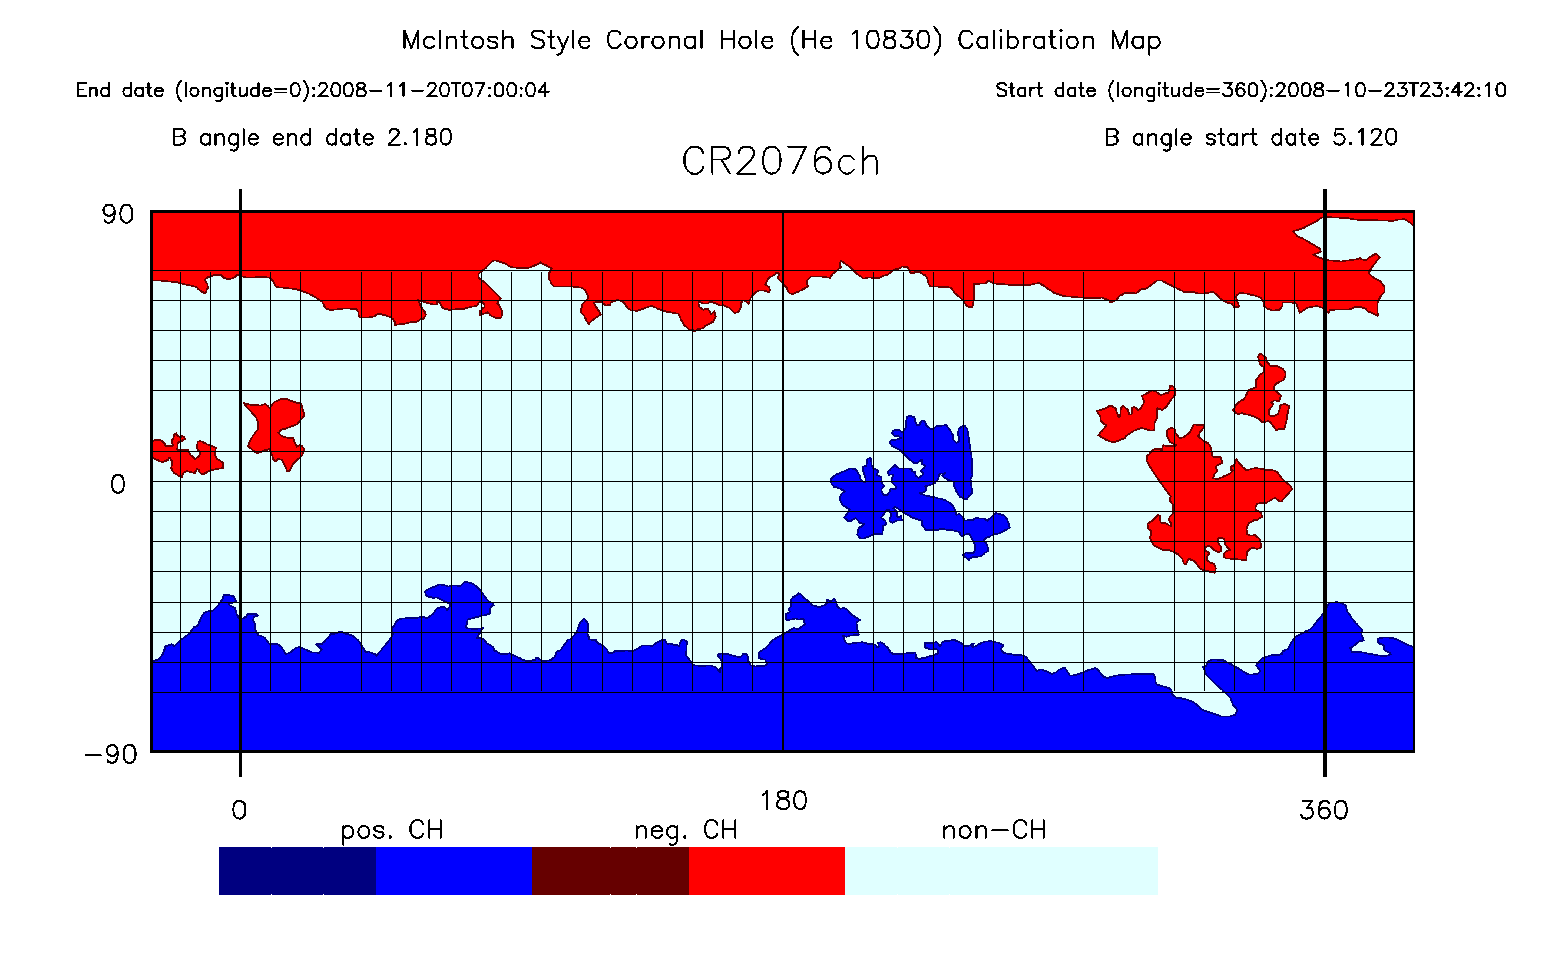
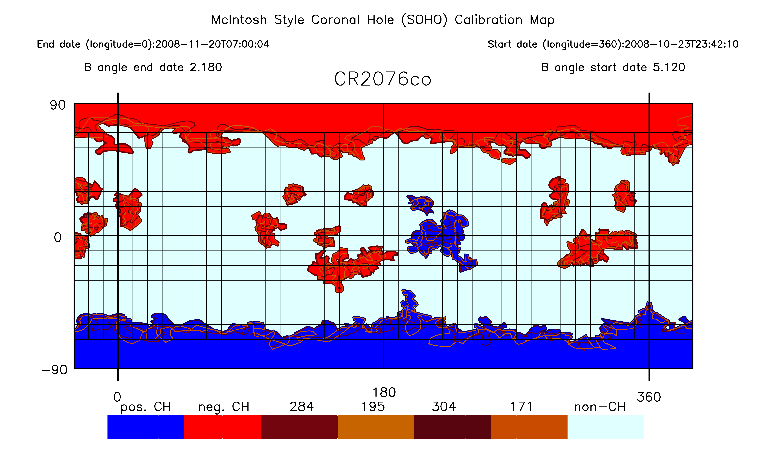
Cross Calibration of HE 10830 Å to Extreme Ultraviolet (EUV)
CR2076 – October 2008 – Solar minimum SC23-24
We found significantly more coronal holes in the EUV data at solar minimum.
Left map – He 10830 Å Right Map - SOHO EUV

Slide 18
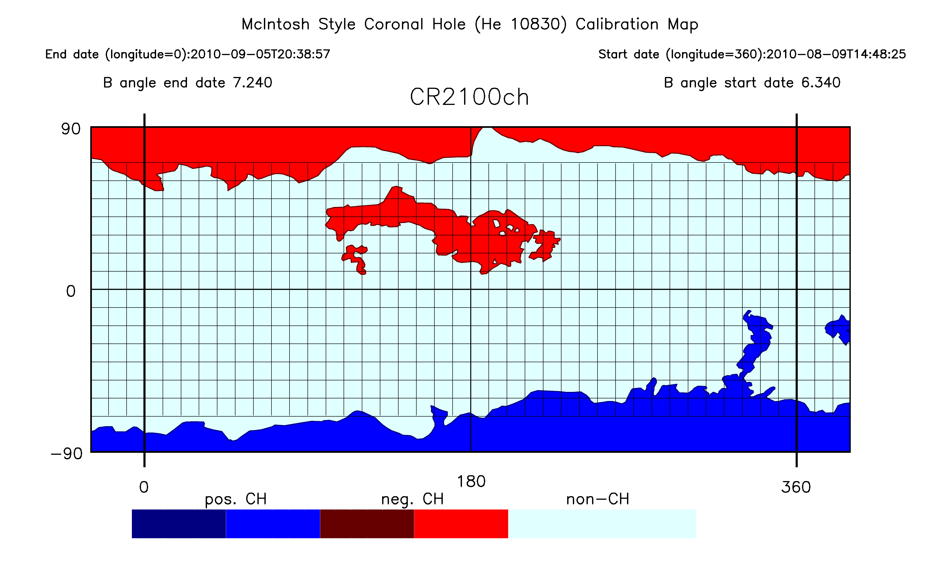
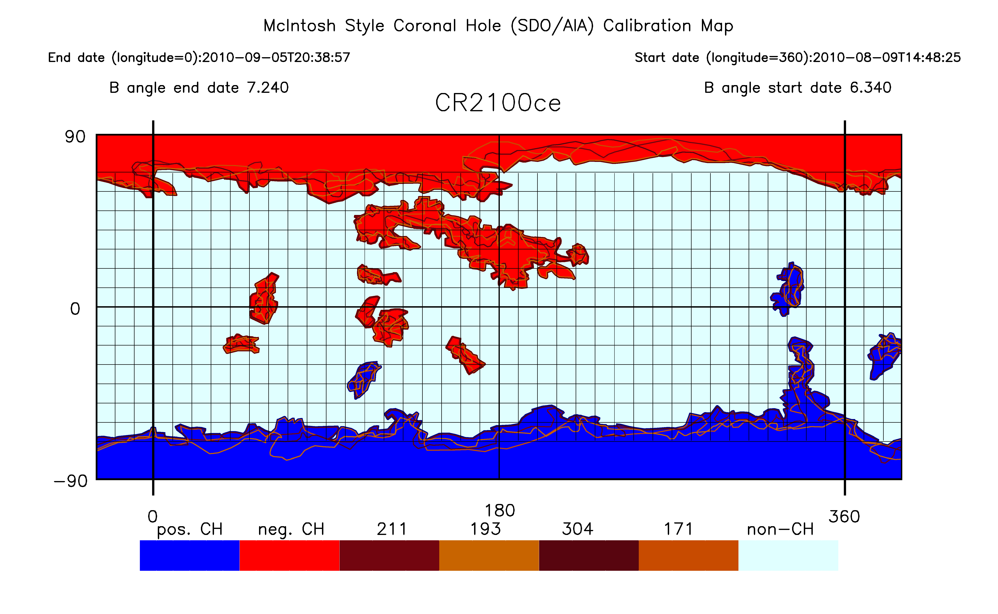
Cross Calibration of HE 10830 Å to Extreme Ultraviolet (EUV)
CR2100 – August 2010 – Early ascending phase SC24
Still significantly more coronal holes in the EUV data at solar minimum.
Left map – He 10830 Å Right Map - SDO EUV

Slide 19
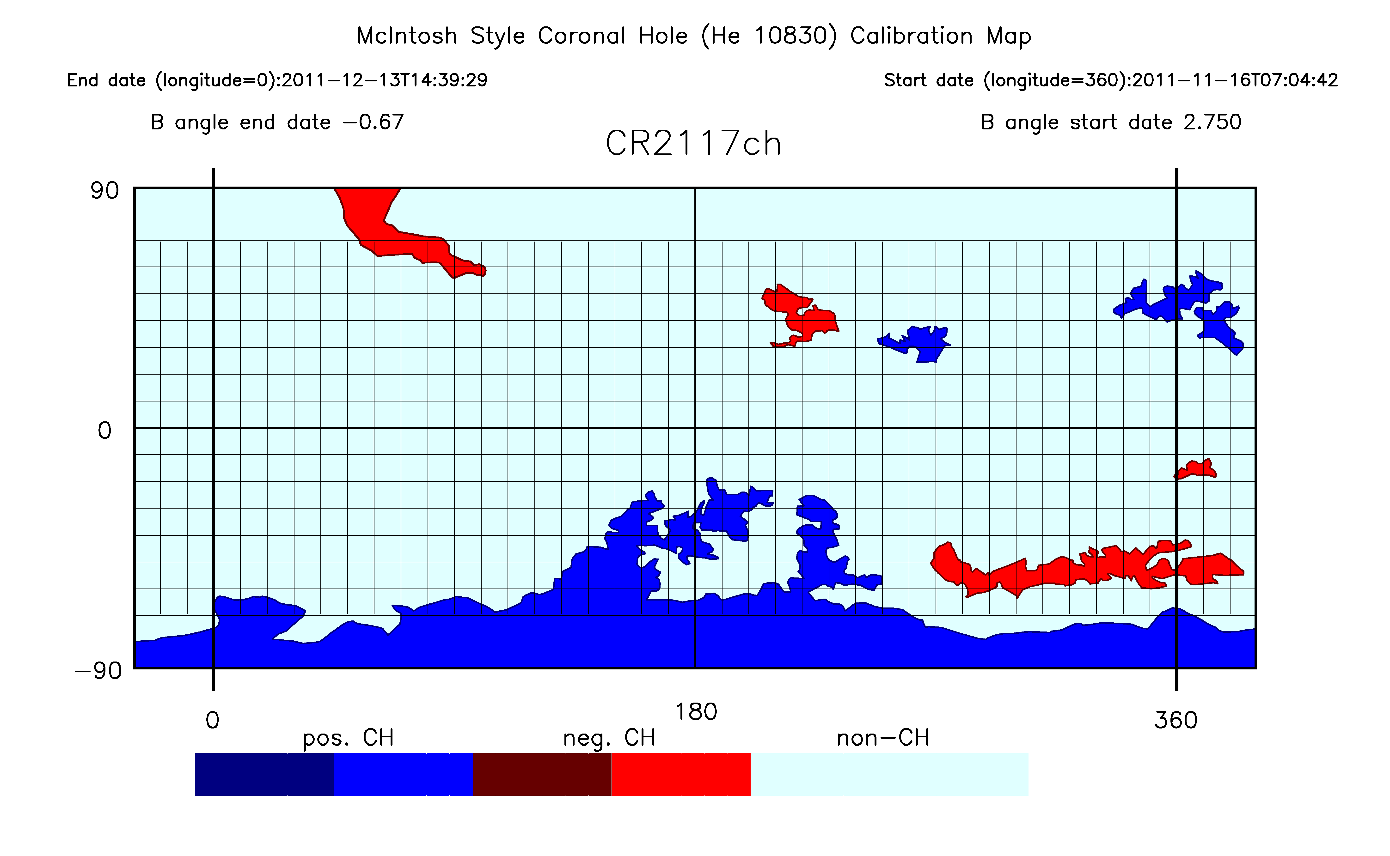
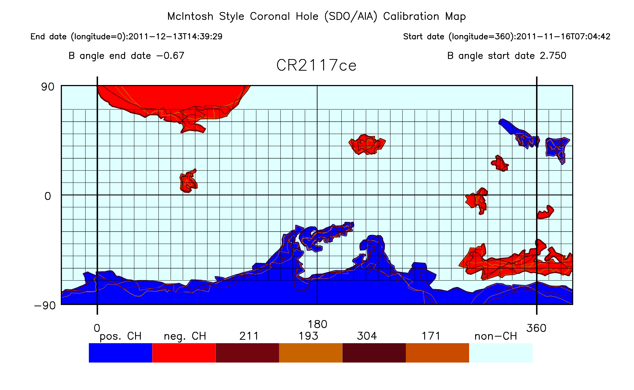
Cross Calibration of HE 10830 Å to Extreme Ultraviolet (EUV)
CR2117 – November 2011 – Ascending phase SC24
Still more coronal holes in the EUV data at solar minimum.
Left map – He 10830 Å Right Map - SDO EUV

Slide 20
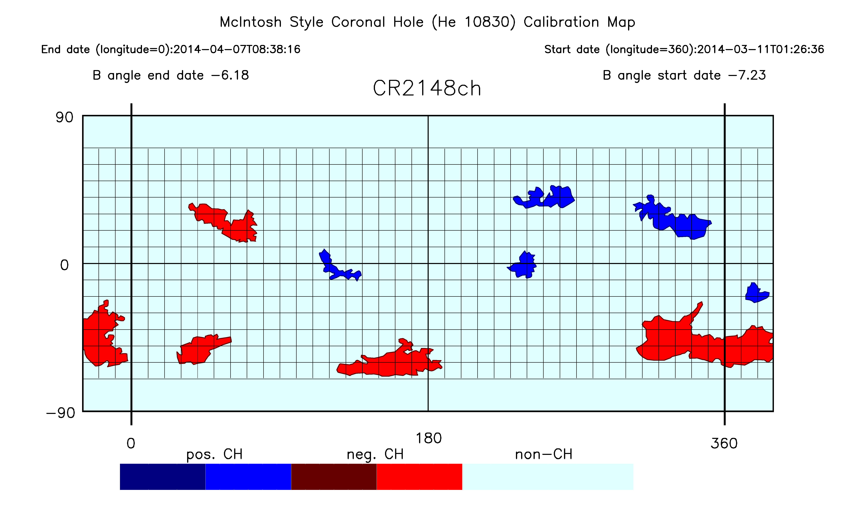
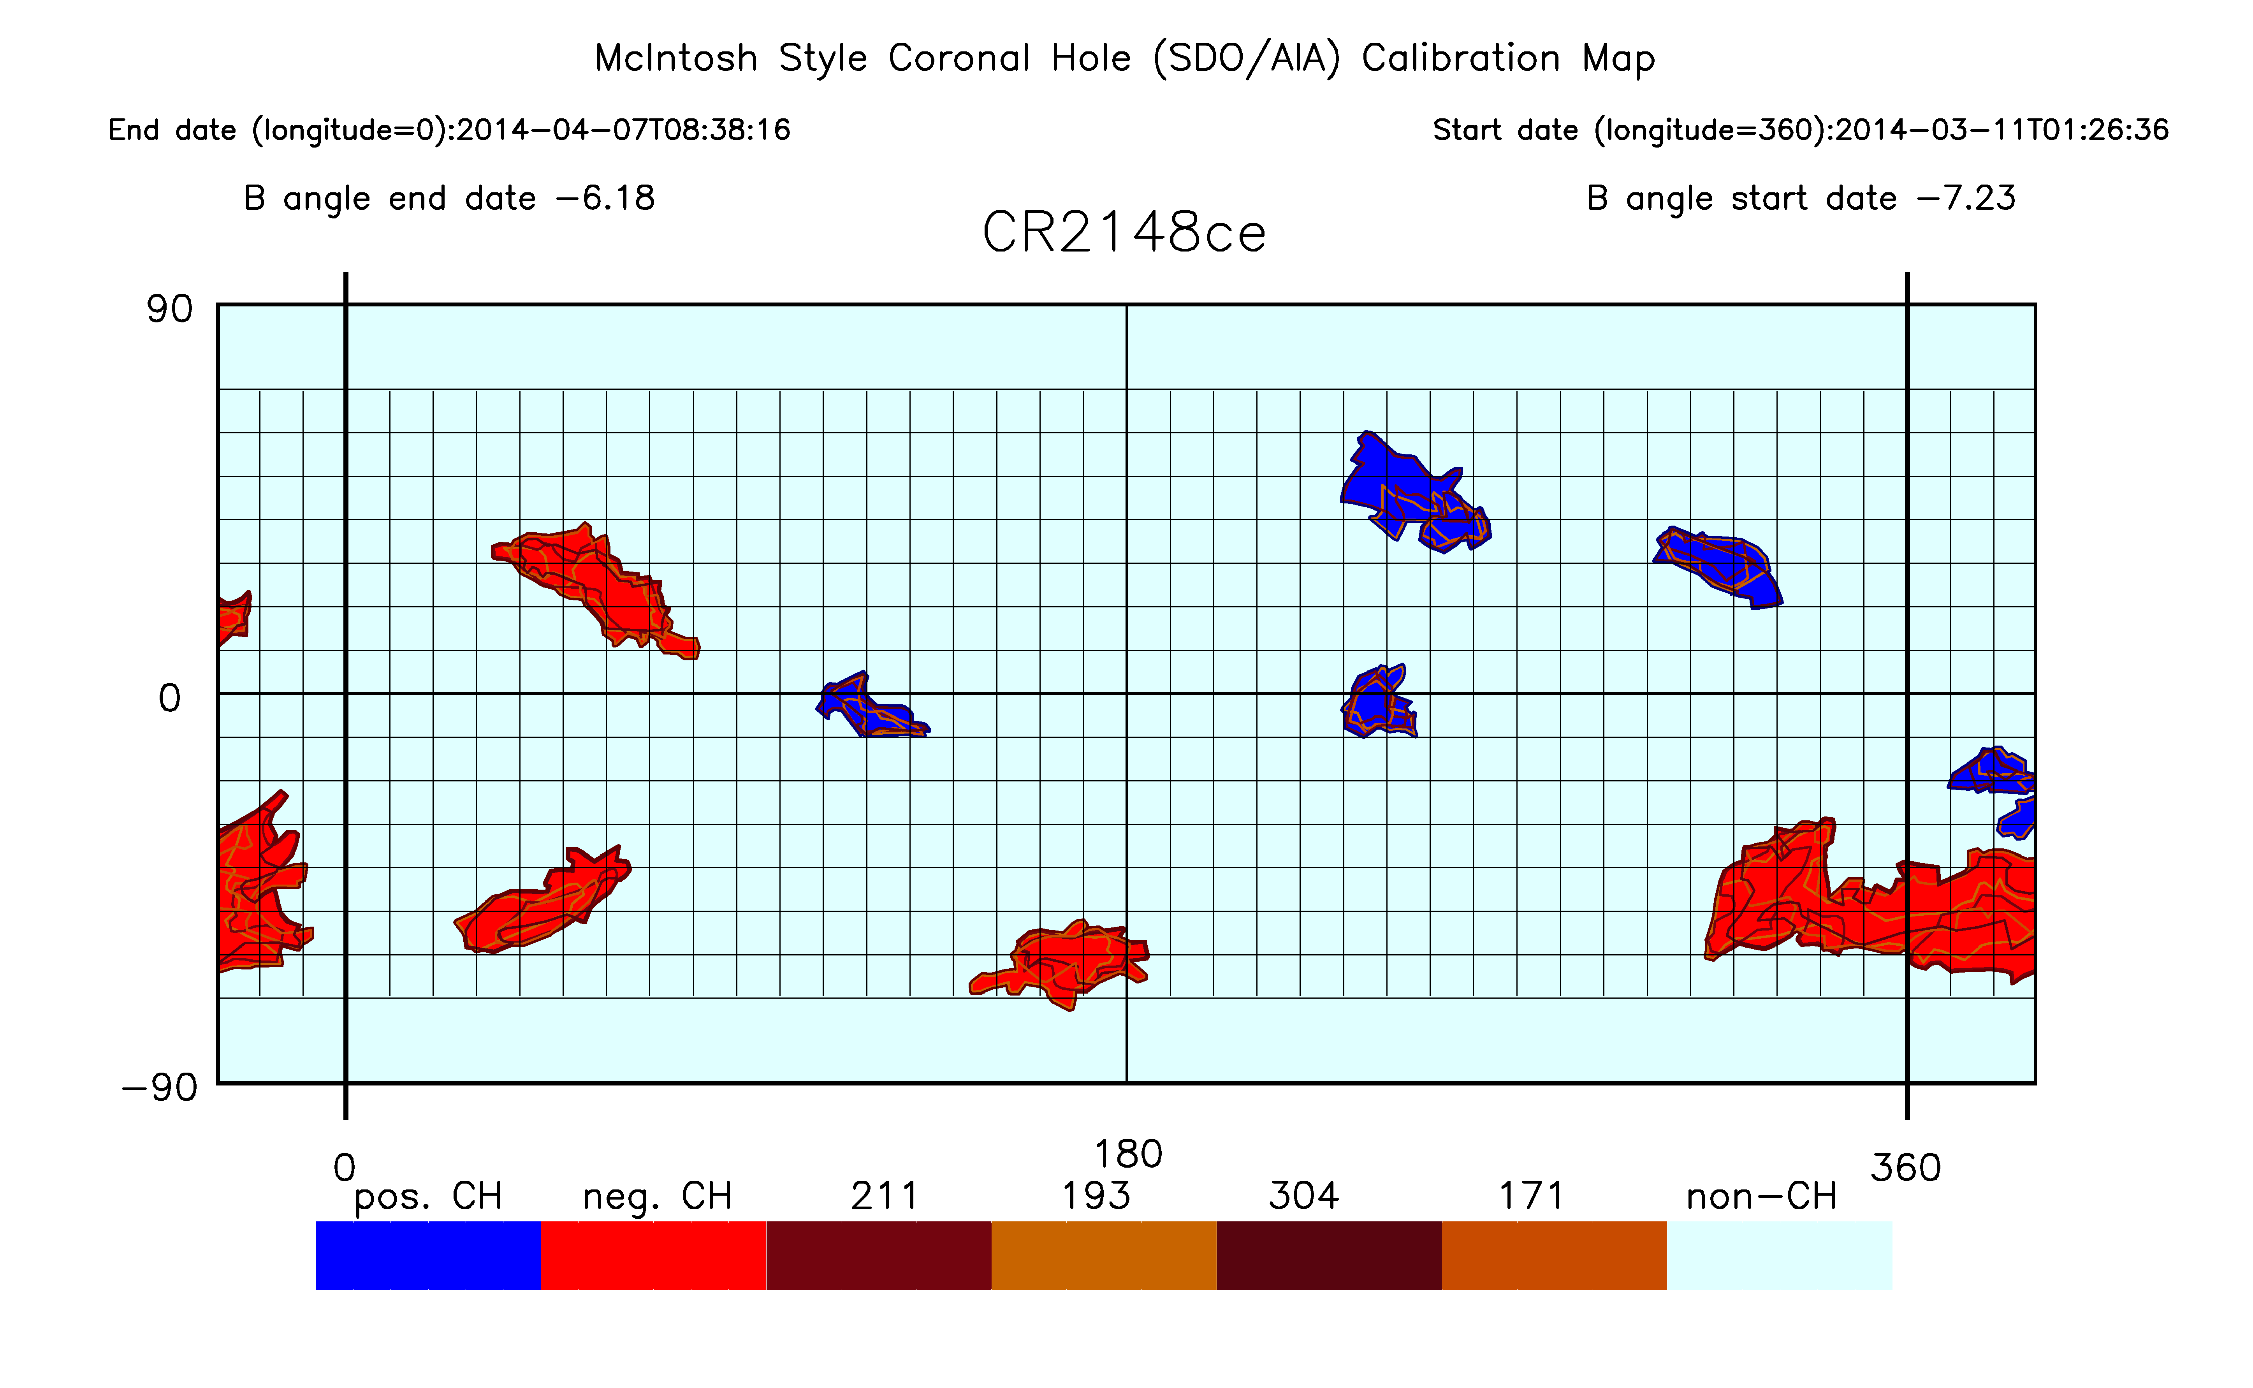
Cross Calibration of HE 10830 Å to Extreme Ultraviolet (EUV)
CR2148 – March 2014 – Near Solar Maximum SC24
Excellent agreement of coronal hole positions and sizes in the data at solar maximum.
Left map – He 10830 Å Right Map - SDO EUV

Slide 21
Cross Calibration of HE 10830 Å to Extreme Ultraviolet (EUV)
How do this result affect our solar minima study?

Slide 22
Cross Calibration of HE 10830 Å to Extreme Ultraviolet (EUV)
How do this result affect our solar minima study?
If we can’t compare numbers or sizes of coronal holes at minimum because of the change from He 10830 Å to EUV data, what can we compare?

Slide 23
Cross Calibration of HE 10830 Å to Extreme Ultraviolet (EUV)
How do this result affect our solar minima study?
If we can’t compare numbers or sizes of coronal holes at minimum because of the change from He 10830 Å to EUV data, what can we compare?
We can look at lifetimes of coronal holes. How many rotations do coronal holes from multiple solar cycles last at solar minimum ?

Slide 24
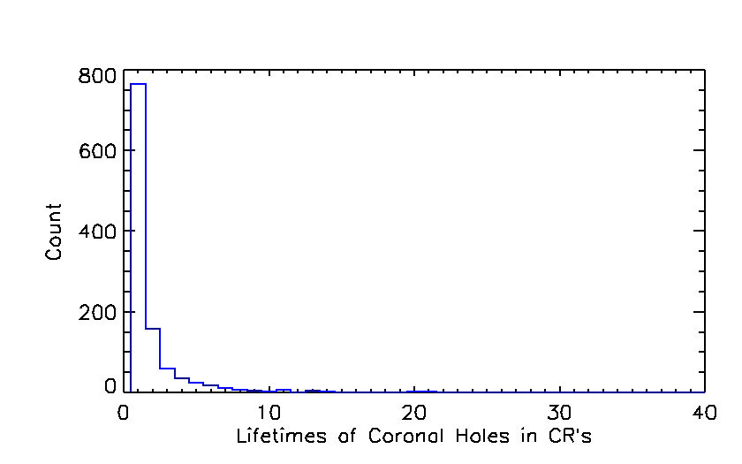
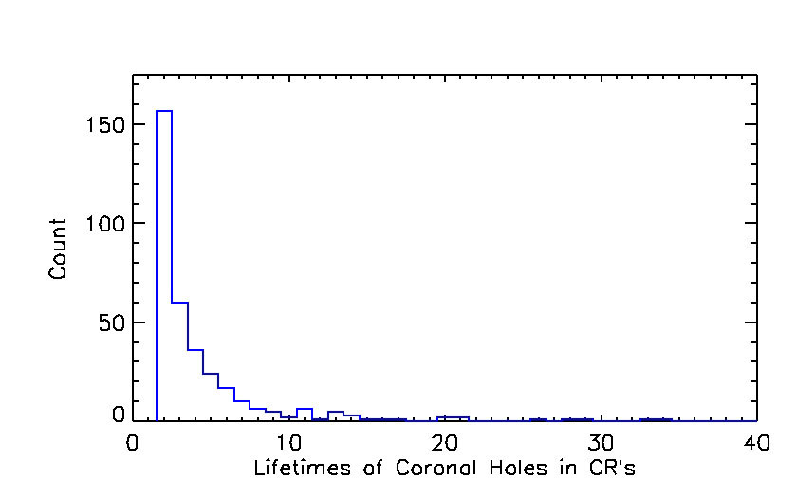
Cross Calibration of HE 10830 Å to Extreme Ultraviolet (EUV)
How do this result affect our solar minima study?
In Hewins et al. 2020 approximately 1,100 coronal holes were tracked over multiple rotations to determine their lifetimes. While the vast majority (about 760) were single rotation coronal holes,
about 155 lasted two rotations, about 60 lasted 3 rotations,
about 36 lasted 4 rotations,
about 23 lasted 5 rotations,
about 17 lasted 6 rotations, etc.
One coronal holes lasted for 34 rotations.
If we can’t compare numbers or sizes of coronal holes at minimum because of the change from He 10830 Å to EUV data, what can we compare?
We can look at lifetimes of coronal holes. How many rotations do coronal holes from multiple solar cycles last at solar minimum ?

Slide 25
Cross Calibration of HE 10830 Å to Extreme Ultraviolet (EUV)
How do this result affect our solar minima study?
In Hewins et al. 2020 approximately 1,100 coronal holes were tracked over multiple rotations to determine their lifetimes. While the vast majority (about 760) were single rotation coronal holes,
about 155 lasted two rotations, about 60 lasted 3 rotations,
about 36 lasted 4 rotations,
about 23 lasted 5 rotations,
about 17 lasted 6 rotations, etc.
One coronal holes lasted for 34 rotations.
If we can’t compare numbers or sizes of coronal holes at minimum because of the change from He 10830 Å to EUV data, what can we compare?
We can look at lifetimes of coronal holes. How many rotations do coronal holes from multiple solar cycles last at solar minimum ?
So, we can compare lifetimes of coronal holes in the declining and minimum phases of solar cycles.

Slide 26
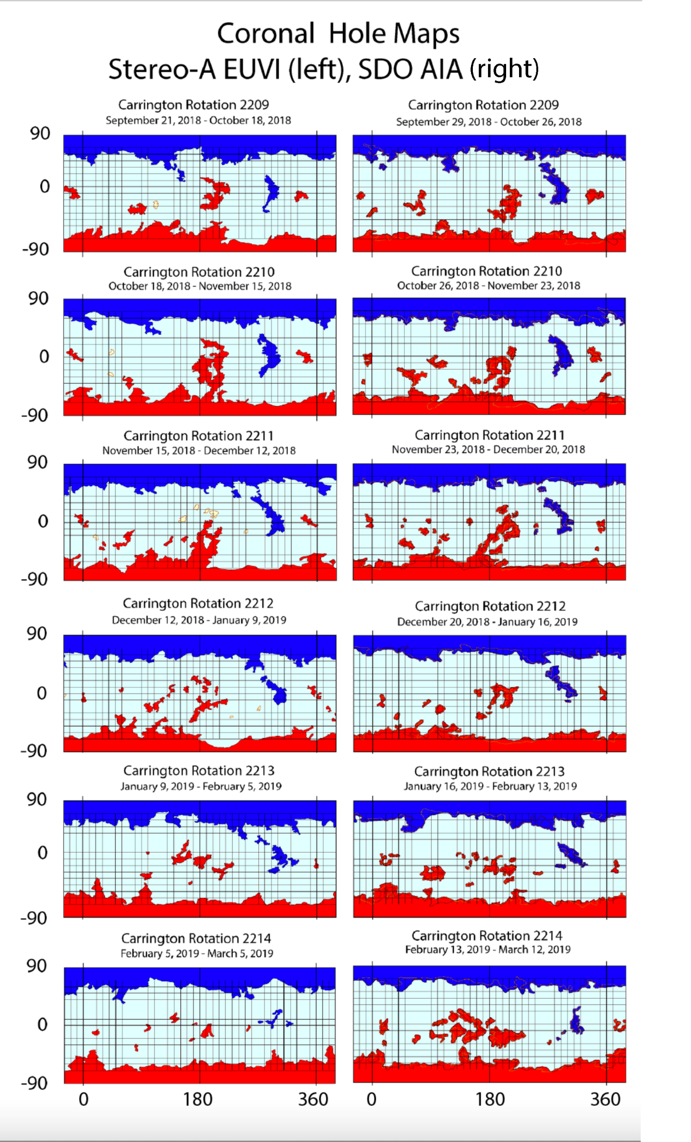
WHPI Coronal Hole maps – CRs 2209 – 2214
October 2018 – March 2019
Left are Stereo A maps right are SDO maps.
Note the recurring coronal holes.
Blue or positive polarity coronal hole at about 280 degrees in the northern hemisphere.
Red or negative polarity cluster of coronal holes at about 190 degrees in the southern hemisphere.

Slide 27
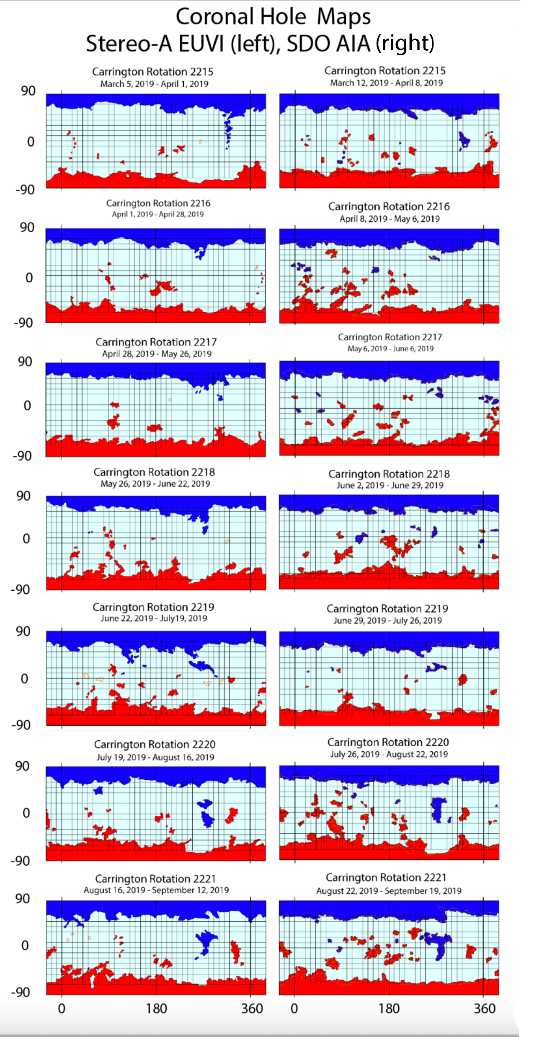
WHPI Coronal Hole maps – CRs 2215 – 2221
March 2019 – September 2019
Left are Stereo A maps right are SDO maps.
Note the recurring coronal holes.
Blue or positive polarity coronal hole at about 280 degrees in the northern hemisphere.
Red or negative polarity cluster of coronal holes at about 190 degrees in the southern hemisphere.

Slide 28
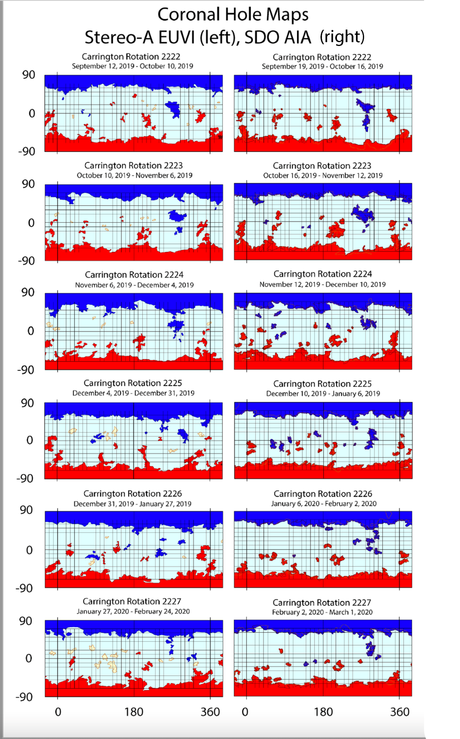
WHPI Coronal Hole maps – CRs 2222 – 2227
September 2019 – March 2020
Left are Stereo A maps right are SDO maps.
Note the recurring coronal holes.
Blue or positive polarity coronal hole at about 280 degrees in the northern hemisphere.
Red or negative polarity cluster of coronal holes at about 190 degrees in the southern hemisphere.

Slide 29
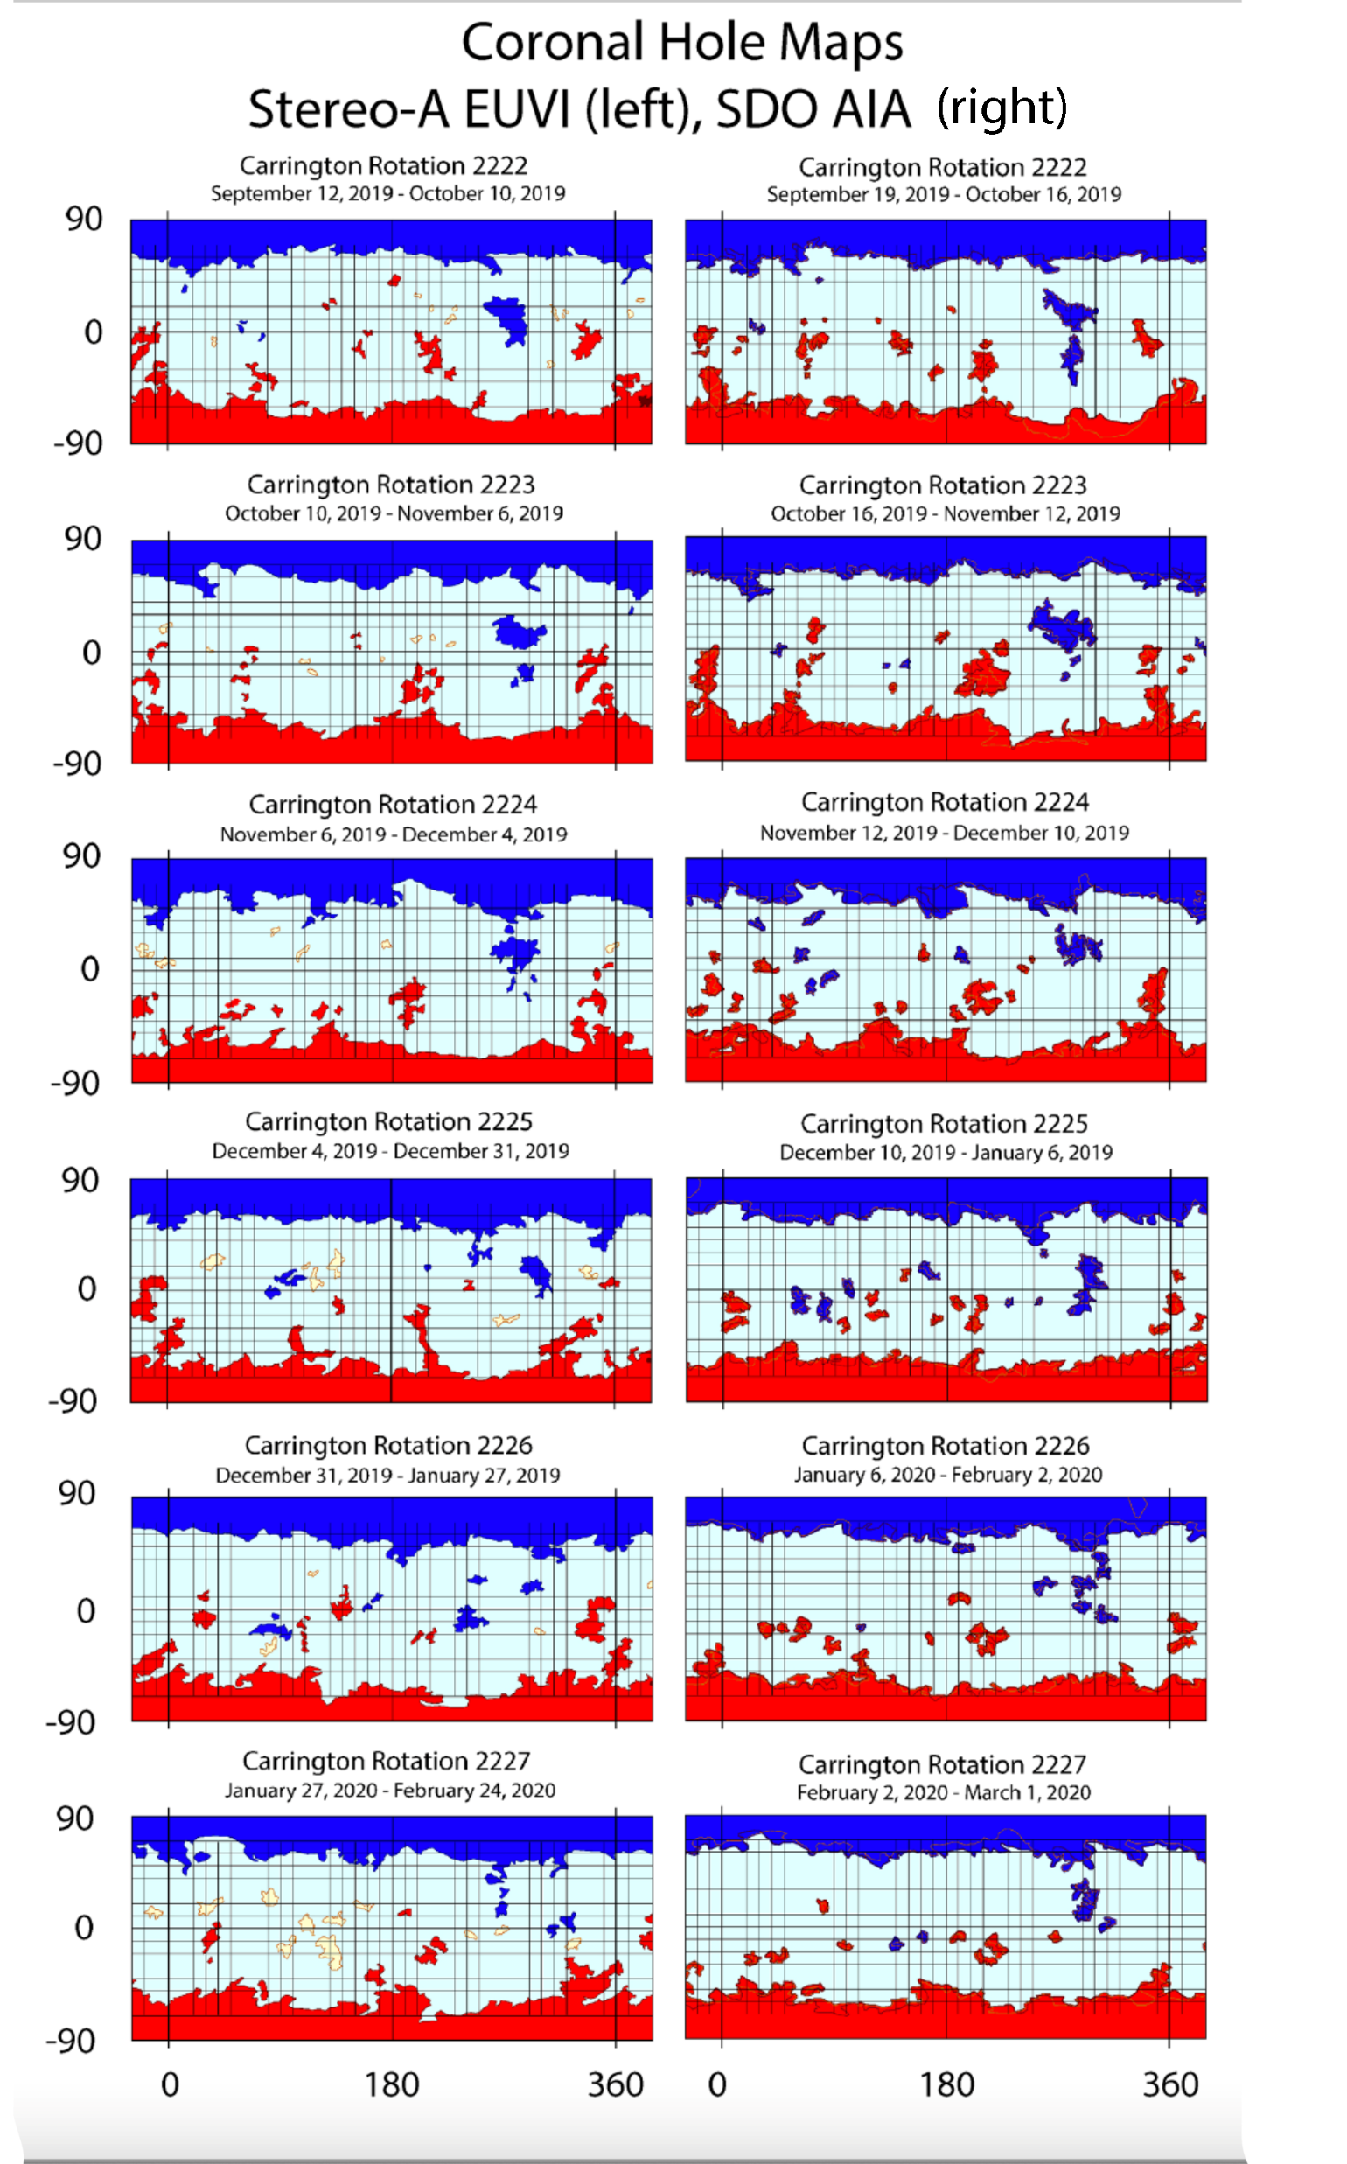

Slide 30
Low-latitude (non-polar) coronal holes at solar cycle minimum
Column 3: Total unique coronal holes (some may recur in multiple CRs)
Column 4: Lifetime (in CR) of longest-lived low-latitude coronal hole
Columns 5 and 6: Central longitude and latitude of longest-lived low-latitude coronal hole at first appearance during 7-month interval
* no coronal holes longer than one rotation
! coronal holes from EUV images
Positive and negative polarities are presented separately (pos/neg)
SC CR Total Lifetime (CR) Longitude (◦) Latitude (◦) 21-22 1776-1782 6/3 1/2 */22 */26 22-23 1910-1916 3/2 3/1 291/* 0/* 23-24 2074-2080 8/16 2/7 206/298 14/-10 24-25! 2221-2227 27/39 7/7 275/206 9/-14

Slide 31
Low-latitude (non-polar) coronal holes at solar cycle minimum and in the declining phase
Column 3: Total unique coronal holes (some may recur in multiple CRs)
Column 4: Lifetime (in CR) of longest-lived low-latitude coronal hole
Columns 5 and 6: Central longitude and latitude of longest-lived low-latitude coronal hole at first appearance during 7-month interval
* no coronal holes longer than one rotation
! coronal holes from EUV images
Positive and negative polarities are presented separately (pos/neg)
SC CR Total Lifetime (CR) Longitude (◦) Latitude (◦) 21-22 1764-1782 9/11 4/8 258/13 -12/11 22-23 1898-1916 23/4 6/1 321/* 13/* 23-24 2062-2080 14/18 10/19 127/237 -18/-5 24-25! 2209-2227 55/87 12/14 266/220 34/11.4

Slide 32
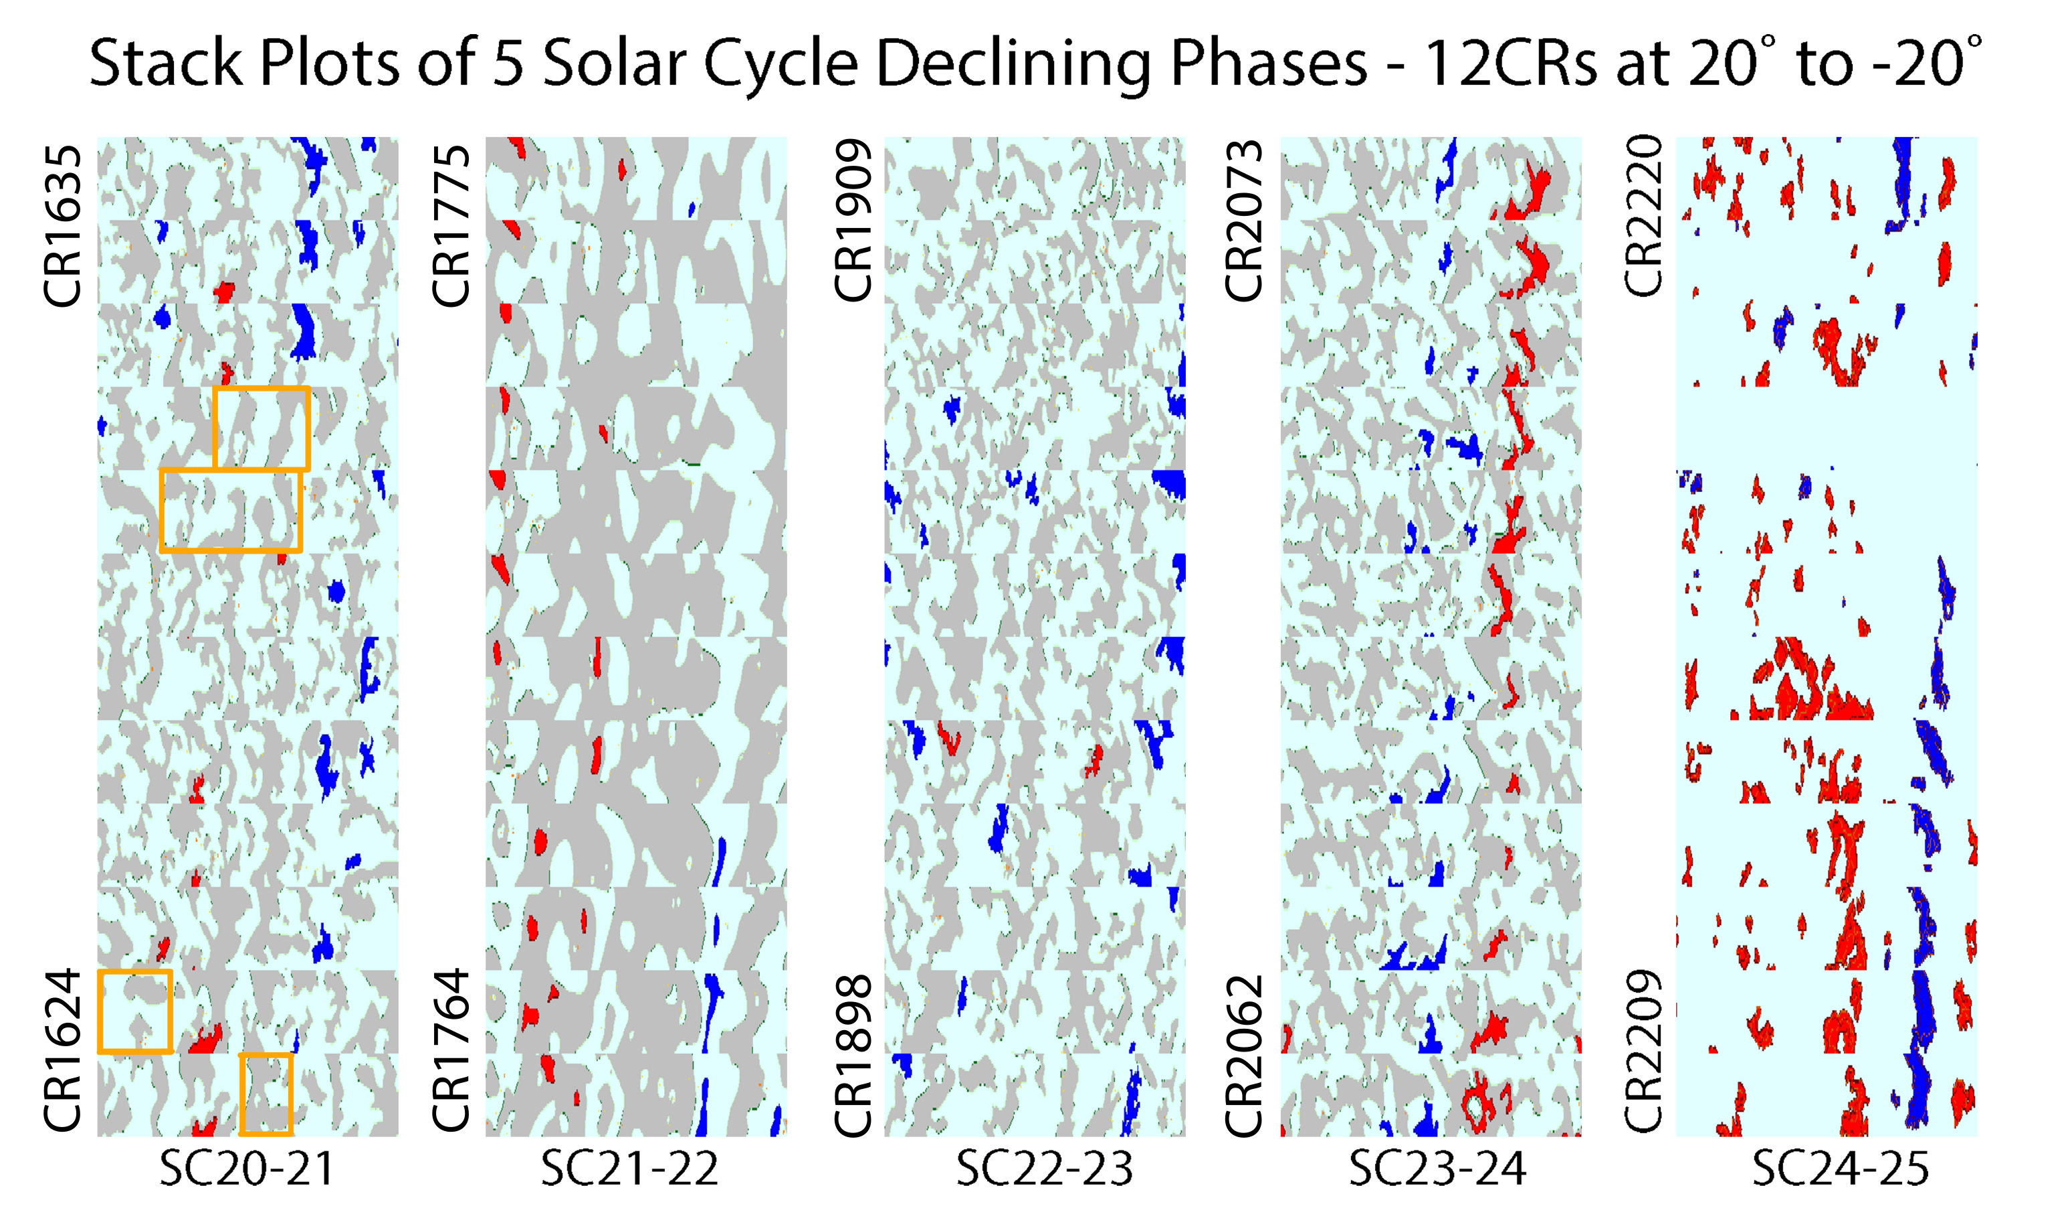
Comparative solar minima and declining phase in Stack Plots
Stacks of latitude slices from McIntosh Archive and WHPI coronal hole maps. Horizontal axis shows 0 – 360 ° longitude at +20° to -20° latitude. Although all minima have some coronal holes present around the equator, SC23-24 and SC24-25 show slightly more coronal holes and certainly longer-lived coronal holes.

Slide 33
Conclusions
Solar minimum represents the period of lowest activity and simplest structure in the sun. Minimum can be seen as a sort of baseline for the normal cyclic activity of the sun. This makes it an excellent time to put together a system wide view of the sun itself and the Sun-Earth system as a whole.

Slide 34
Conclusions
Solar minimum represents the period of lowest activity and simplest structure in the sun. Minimum can be seen as a sort of baseline for the normal cyclic activity of the sun. This makes it an excellent time to put together a system wide view of the sun itself and the Sun-Earth system as a whole.
The results presented here demonstrate the capabilities of the archive in terms of the cross-cycle comparison capabilities, multiple feature comparisons such as open and closed field regions and a temporal focus on individual solar cycle phases. We see clear similarities across multiple cycles but variation within these patterns. We see a clear representation of the Hale cycle in sunspot butterfly plots and a similar pattern in a subset of low-latitude coronal holes.

Slide 35
Conclusions
Solar minimum represents the period of lowest activity and simplest structure in the sun. Minimum can be seen as a sort of baseline for the normal cyclic activity of the sun. This makes it an excellent time to put together a system wide view of the sun itself and the Sun-Earth system as a whole.
The results presented here demonstrate the capabilities of the archive in terms of the cross-cycle comparison capabilities, multiple feature comparisons such as open and closed field regions and a temporal focus on individual solar cycle phases. We see clear similarities across multiple cycles but variation within these patterns. We see a clear representation of the Hale cycle in sunspot butterfly plots and a similar pattern in a subset of low-latitude coronal holes.
We present a comparison of He 10830 Å to EUV that allows for calibration of data types at different times in the solar cycle. This study highlights the importance of understanding variation in data both in terms of types and of how these types may vary at different times in the solar cycle. We find that biggest difference is that EUV data may show more coronal holes at minimum than He 10830 Å and that open field regions may appear to be more diffuse and where one larger coronal hole may appear in He 10830 Å, multiple smaller coronal holes may appear in the same region with EUV.

Slide 36
Conclusions
Solar minimum represents the period of lowest activity and simplest structure in the sun. Minimum can be seen as a sort of baseline for the normal cyclic activity of the sun. This makes it an excellent time to put together a system wide view of the sun itself and the Sun-Earth system as a whole.
The results presented here demonstrate the capabilities of the archive in terms of the cross-cycle comparison capabilities, multiple feature comparisons such as open and closed field regions and a temporal focus on individual solar cycle phases. We see clear similarities across multiple cycles but variation within these patterns. We see a clear representation of the Hale cycle in sunspot butterfly plots and a similar pattern in a subset of low-latitude coronal holes.
We present a comparison of He 10830 Å to EUV that allows for calibration of data types at different times in the solar cycle. This study highlights the importance of understanding variation in data both in terms of types and of how these types may vary at different times in the solar cycle. We find that biggest difference is that EUV data may show more coronal holes at minimum than He 10830 Å and that open field regions may appear to be more diffuse and where one larger coronal hole may appear in He 10830 Å, multiple smaller coronal holes may appear in the same region with EUV.
Finally, during the solar minimum SC24-25 a few largeish coronal holes recurred over numerous CRs that drove solar wind high-speed streams and periodic forcings throughout the solar system. We found the two most recent solar minima had more long-lived low latitude coronal holes than the previous ones, possibly due to weaker polar magnetic fields.

Slide 37
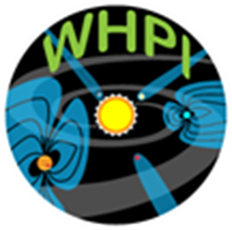
Thank you!
And my thanks to HAO/NCAR
NASA and the WHPI team.

