Slide 1
A Mosaic of the Inner Heliosphere:
Three Carrington Rotations During the Whole Heliosphere and Planetary Interactions Interval
R. C. Allen, S. E. Gibson, I. Hewins, S. K. Vines, L. Qian, G. de Toma, B. J. Thompson, M. Hudson, C. O. Lee, R. J. Filwett, P. Mostafavi, W. Mo, & M. E. Hill
Allen et al., 2023; doi: 10.1029/2023JA031361

Slide 2
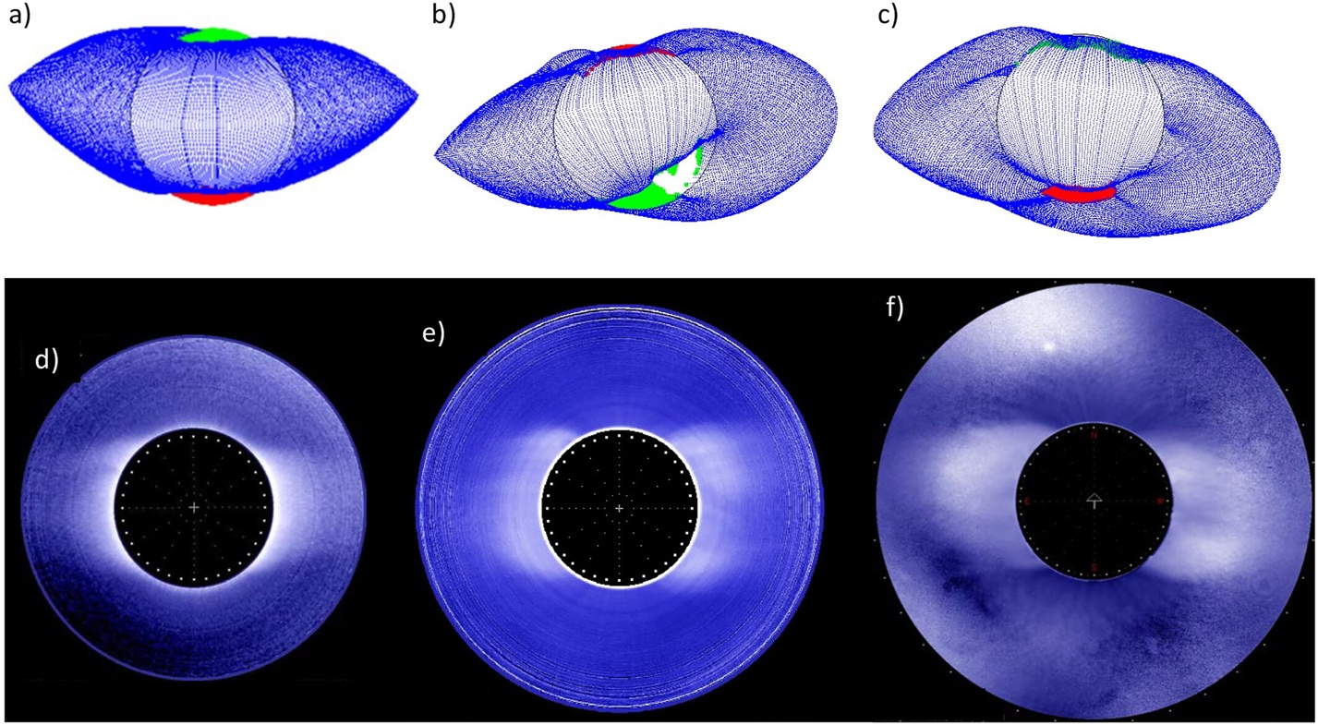
Whole Heliosphere & Planetary Interactions
Solar minimum provides a unique opportunity to observe heliospheric phenomena in isolation
Allows the study of the impacts of certain events in isolation
So, we can connect phenomena from solar origin to the subsequent systems impacted
1996
2008-2009
2019-2020
(Gibson et al., 2023)

Slide 3
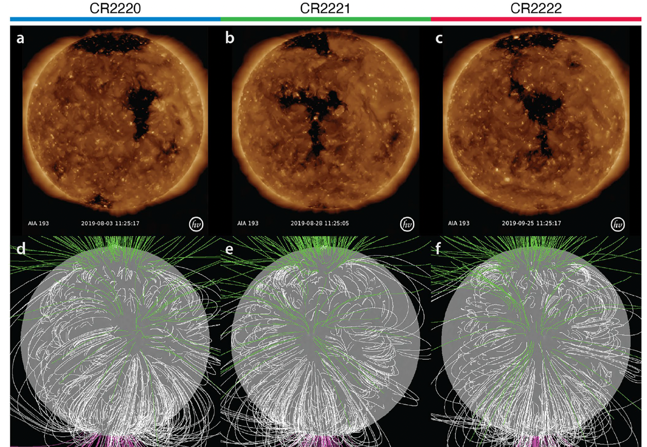
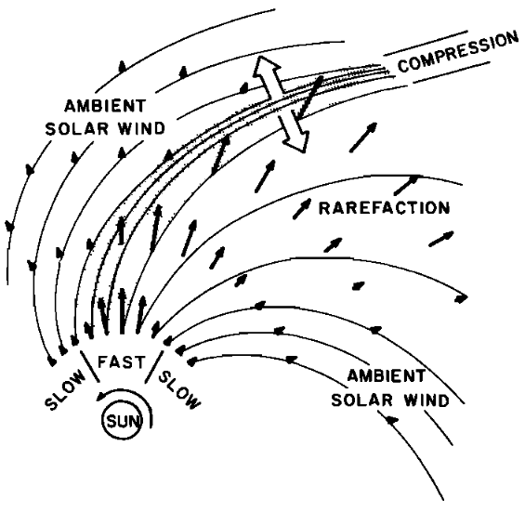
Corotating Interaction Regions
Coronal holes are regions of open magnetic flux which emit high speed solar wind
As these high speed streams expand into the persisting slow solar wind, a compression regions forms which can eventually form a forward and reverse shock pair
As such, these structures sculpt out the heliosphere, impact planetary systems, and are important in solar wind particle acceleration
(Allen et al., 2023)
(Pizzo, 1978)

Slide 4
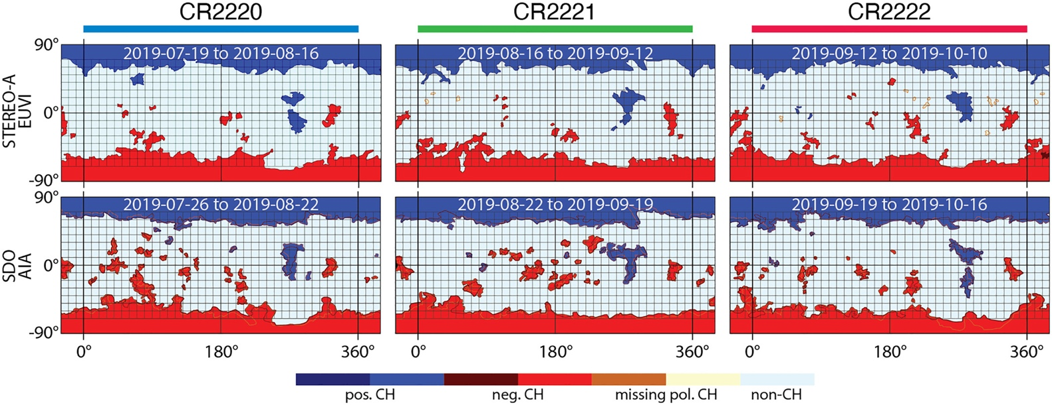
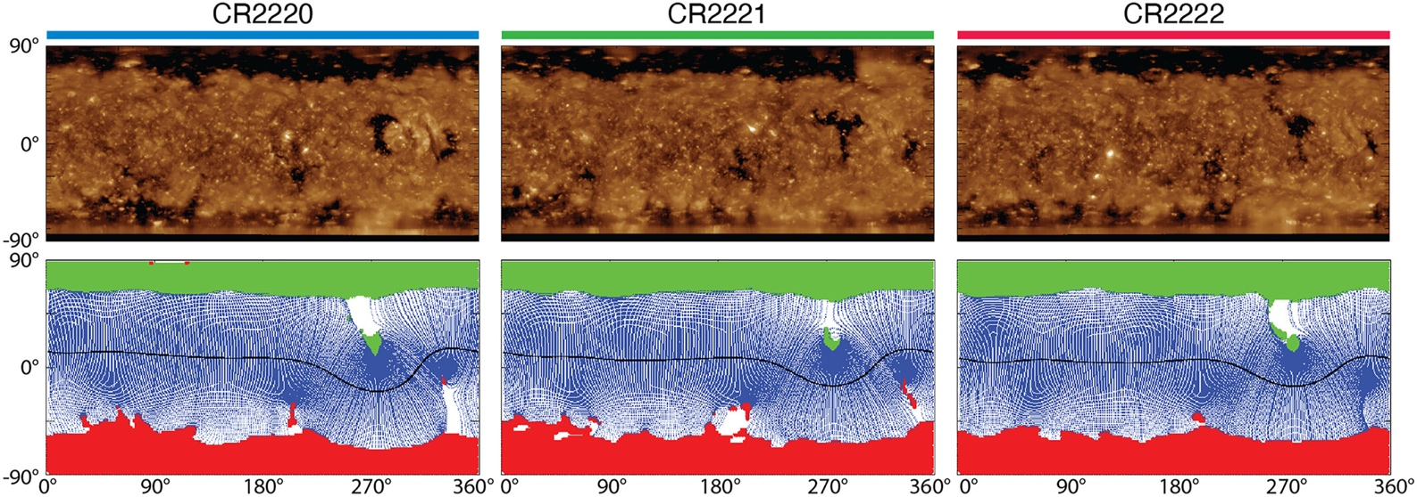
Solar Source

Slide 5
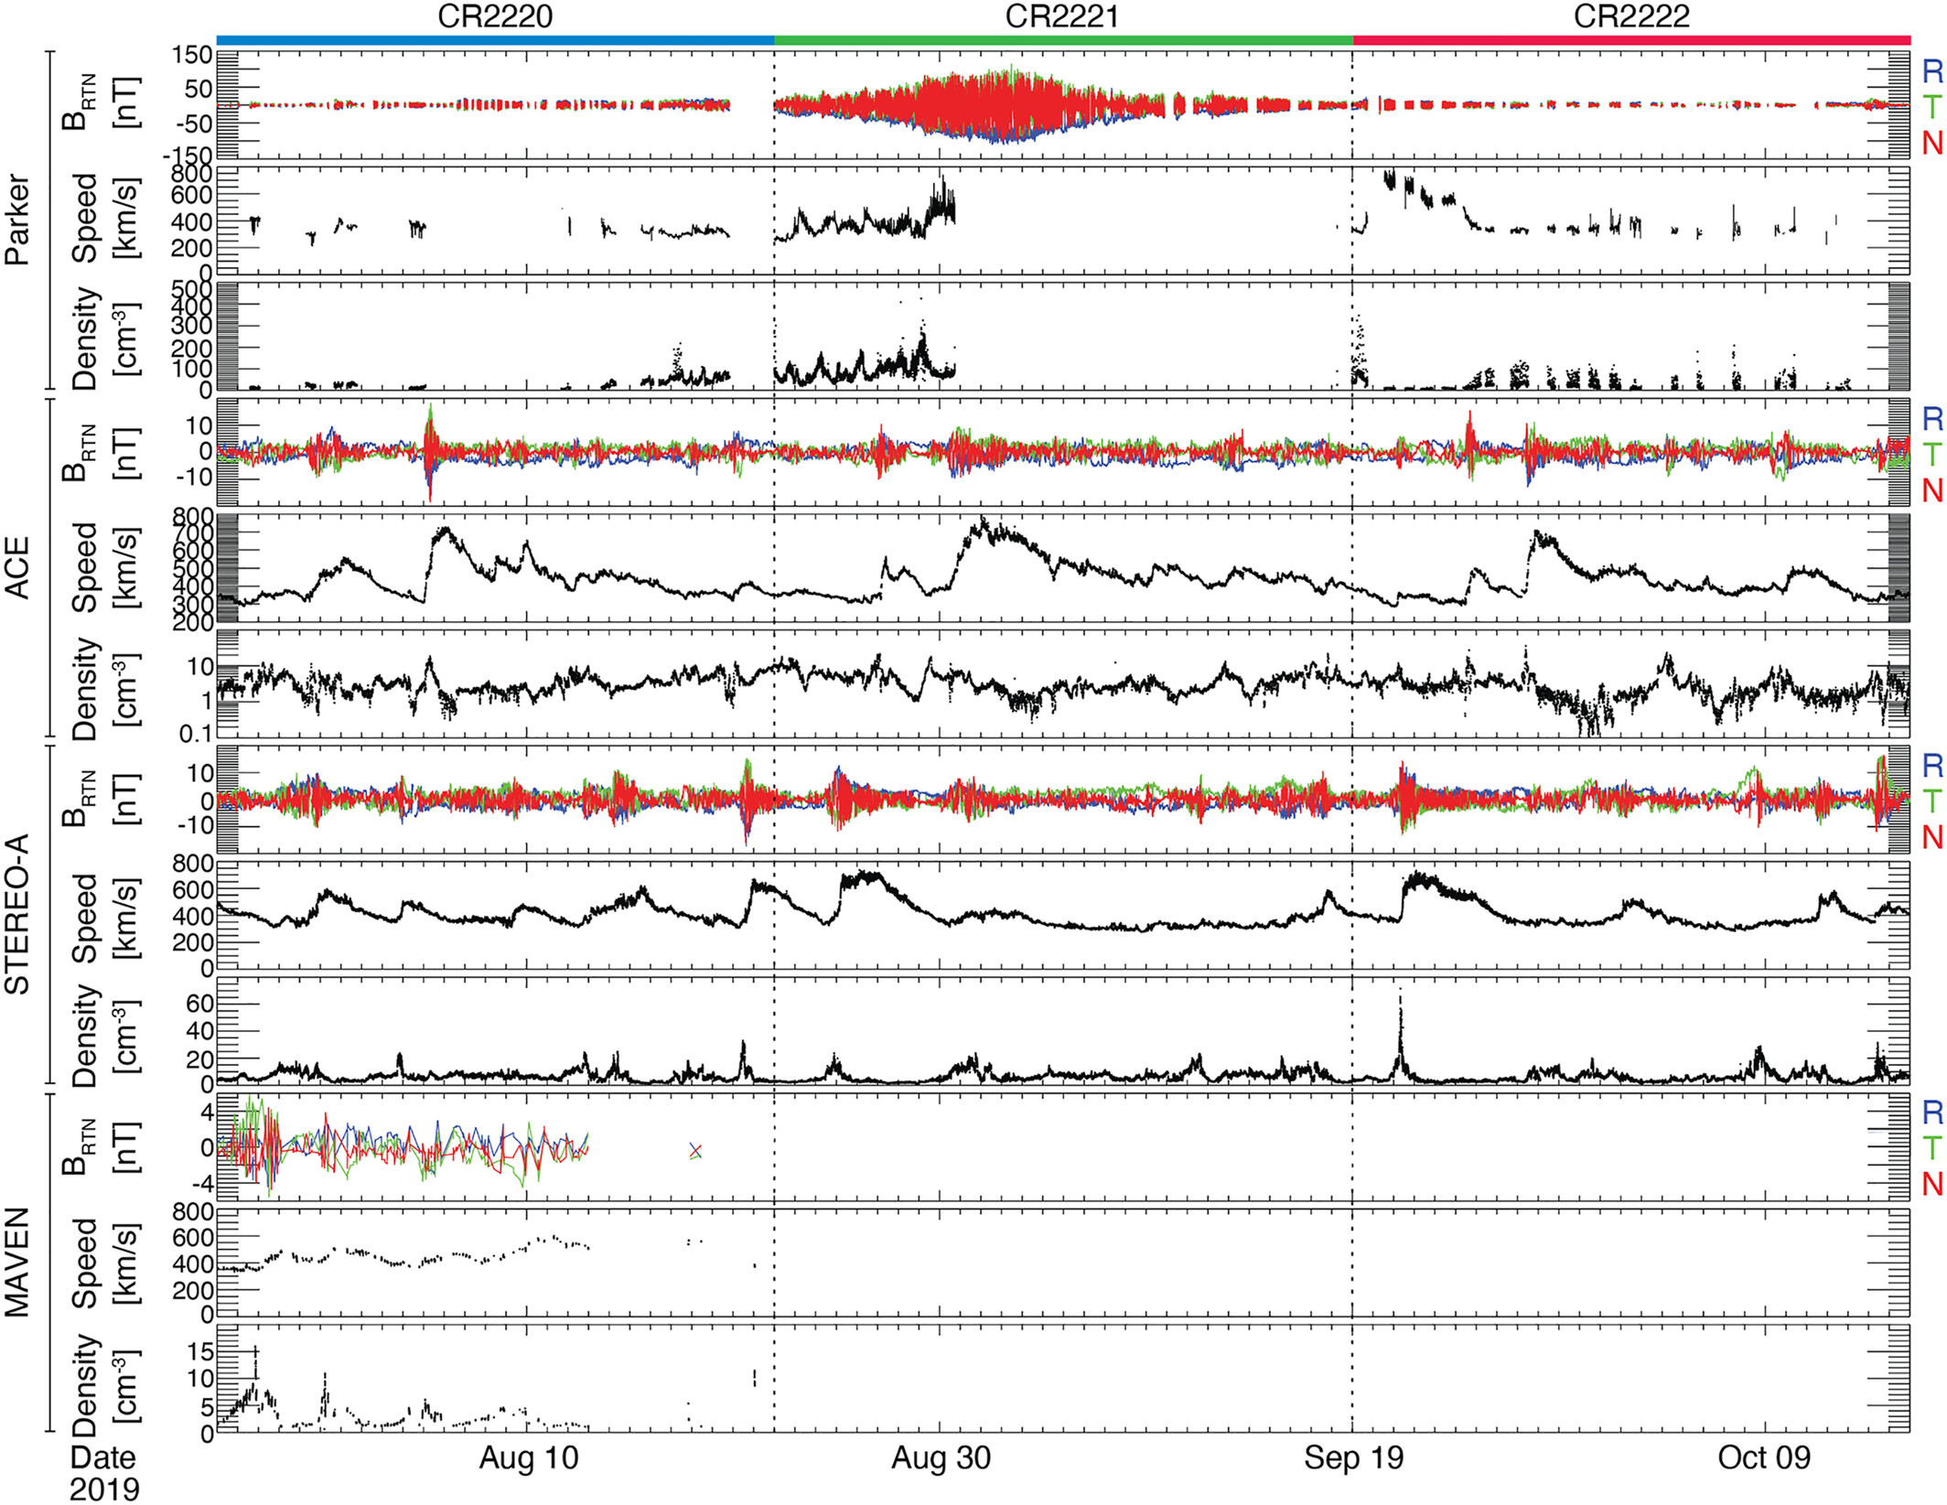
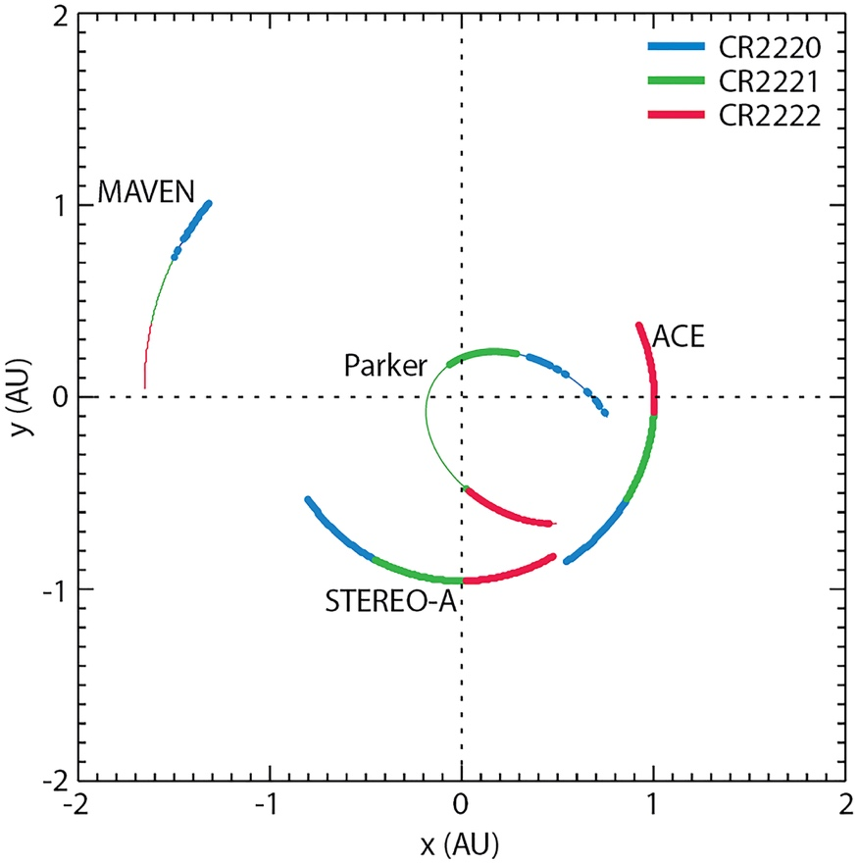
Heliospheric Impacts

Slide 6
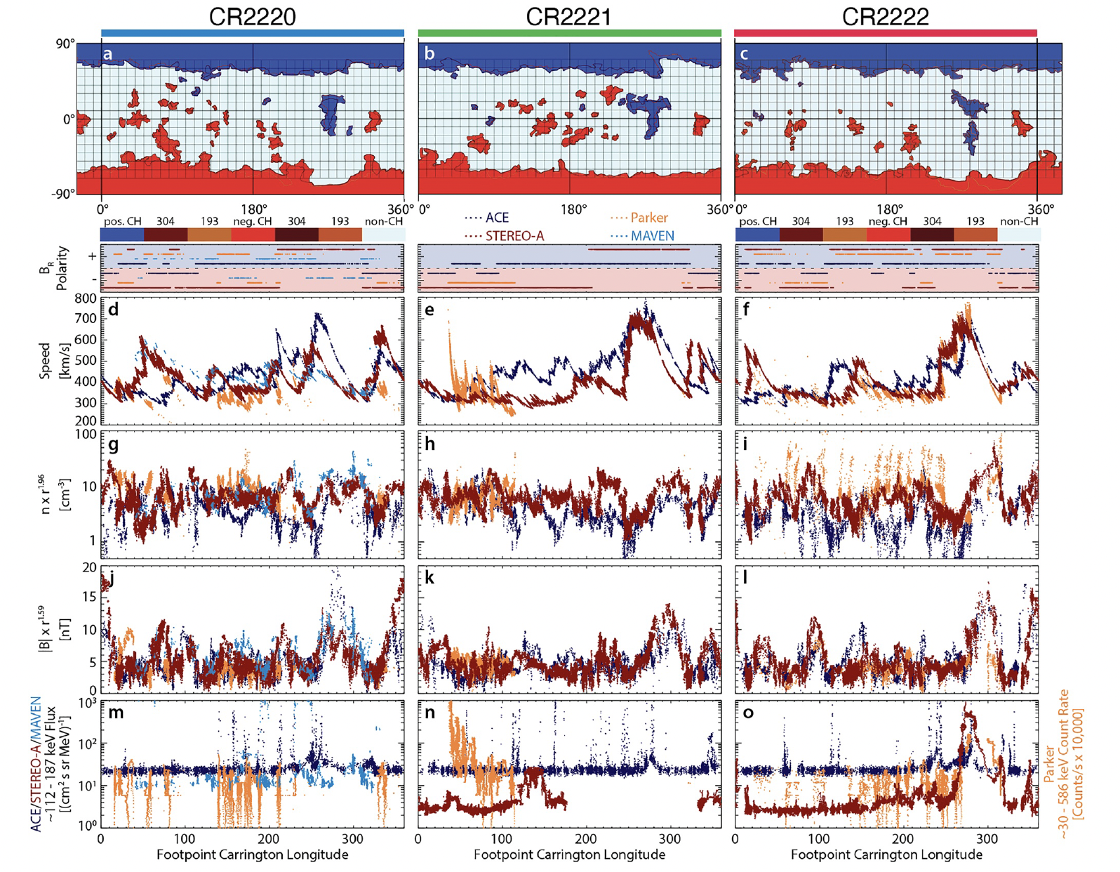
Heliospheric Impacts
Back-mapping solar wind observations to source Carrington longitude illustrates how these structures impact the heliosphere

Slide 7
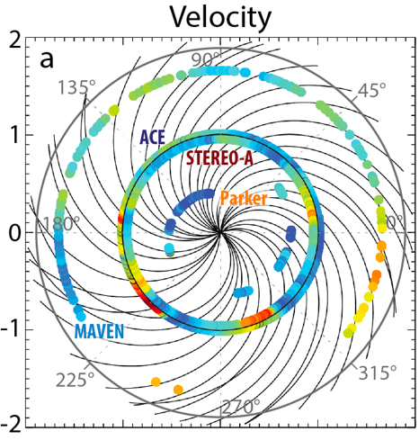
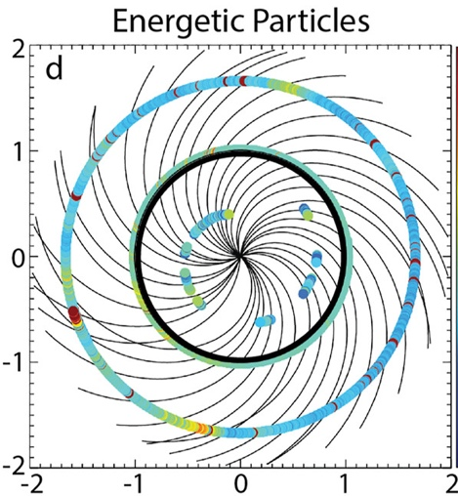
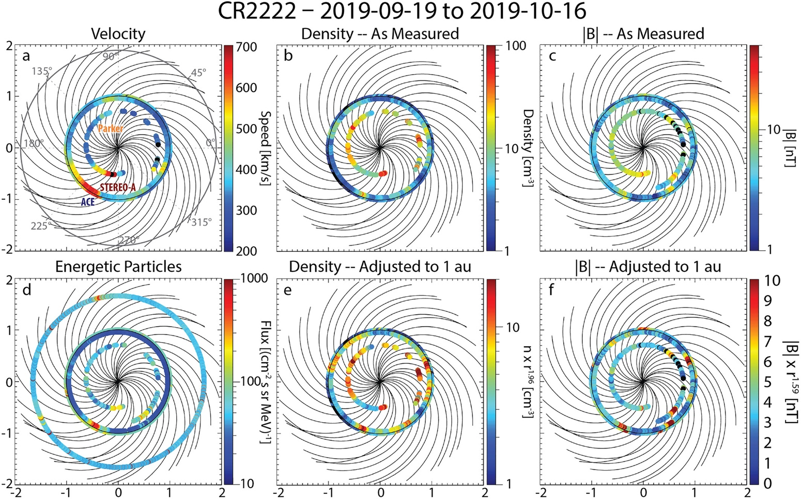
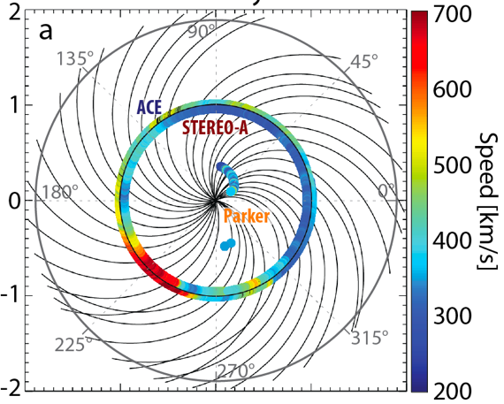
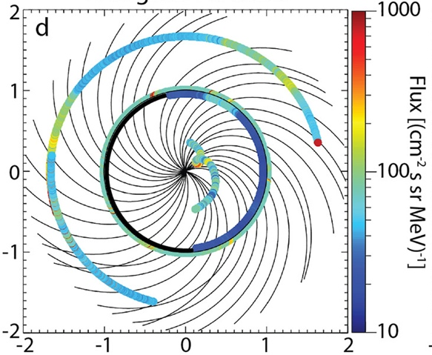
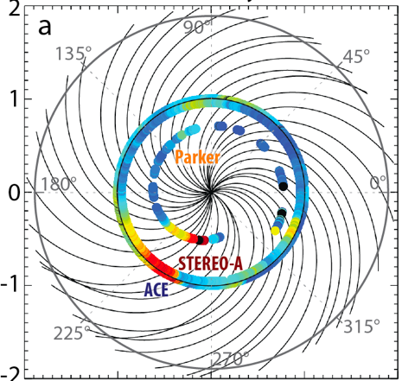
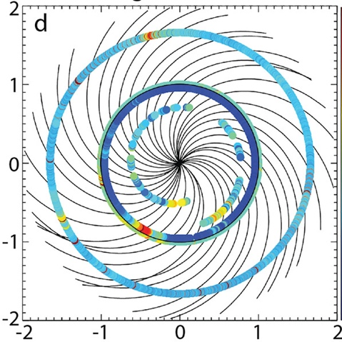
Heliospheric Impacts
Representing the observations along their orbital track reveals both the structure of CIRs in the inner heliosphere as well as discrepancies in observations.

Slide 8
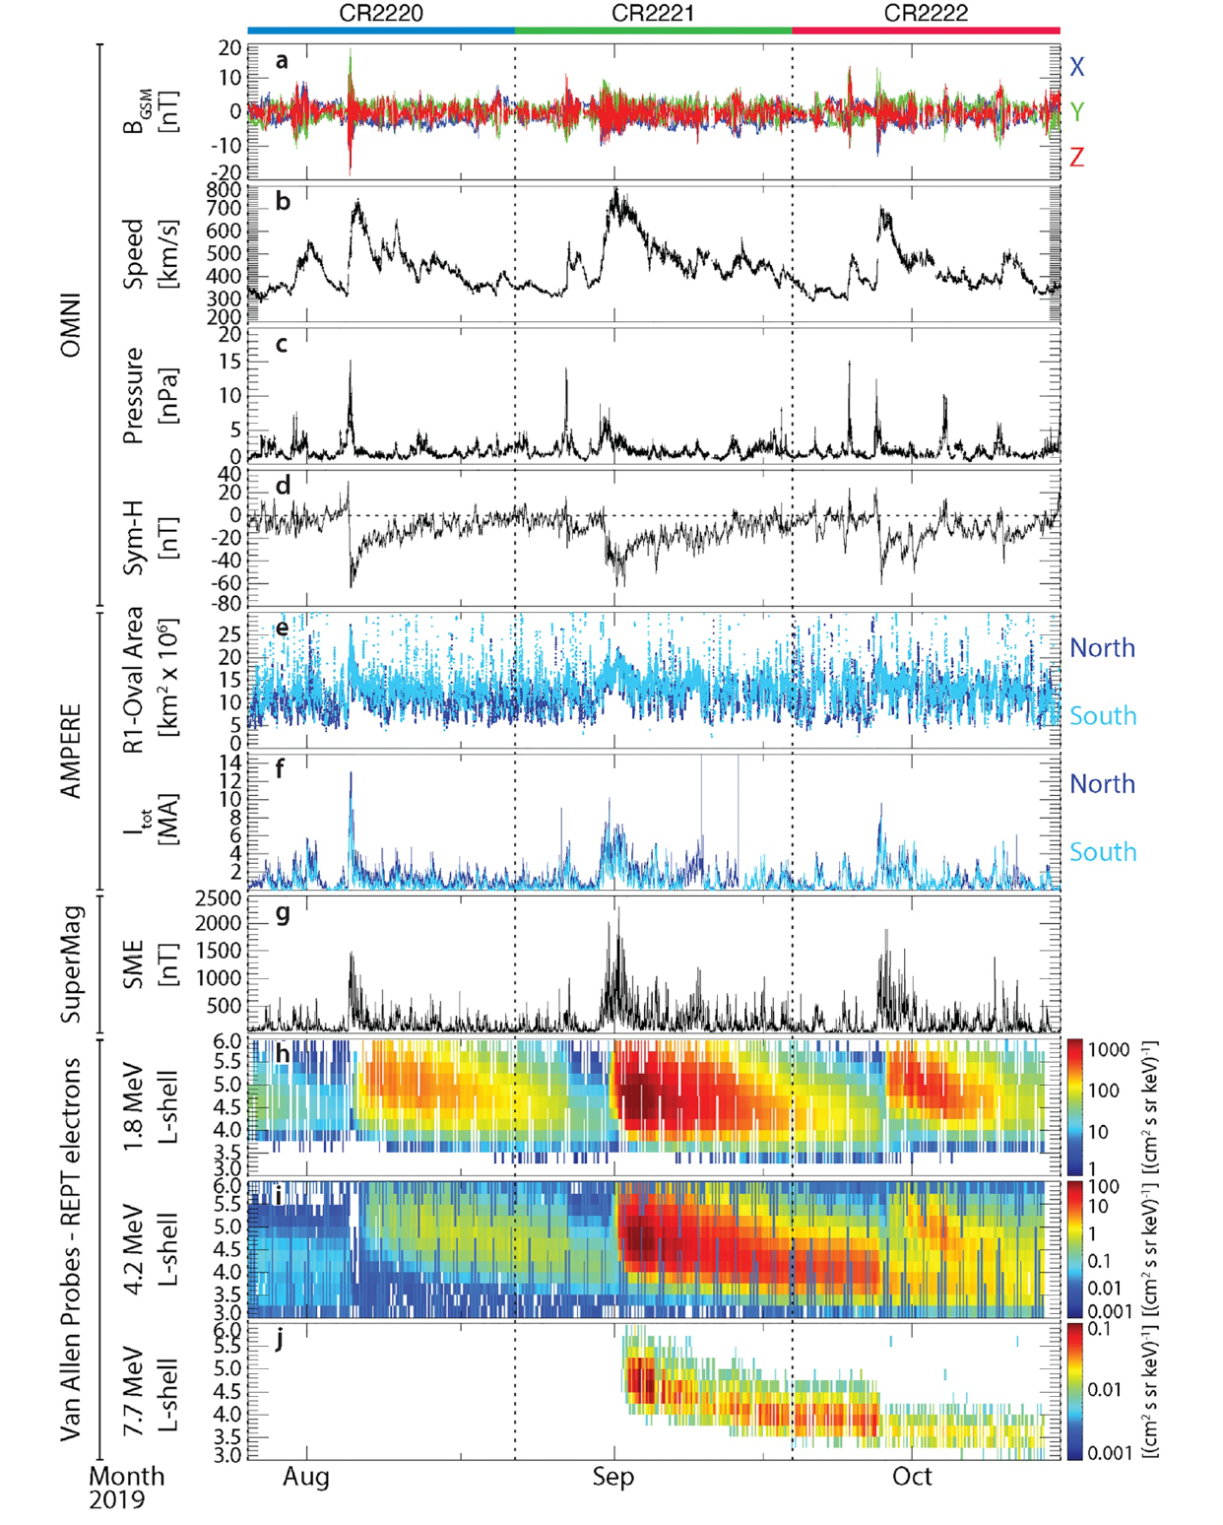
Magnetospheric Impacts
The high speed solar wind with compressed density pile-up region will compress the dayside magnetosphere and drive magnetospheric convection.
This convection and magnetopause compression drive field aligned currents, trigger geomagnetic storms and substorms, and build up the radiation belt.
Notably, the prominent CIR during CR2221 lead to the most pronounced 7.7 MeV radiation belt electron enhancement in over 2 years prior (Hudson et al., 2021).

Slide 9
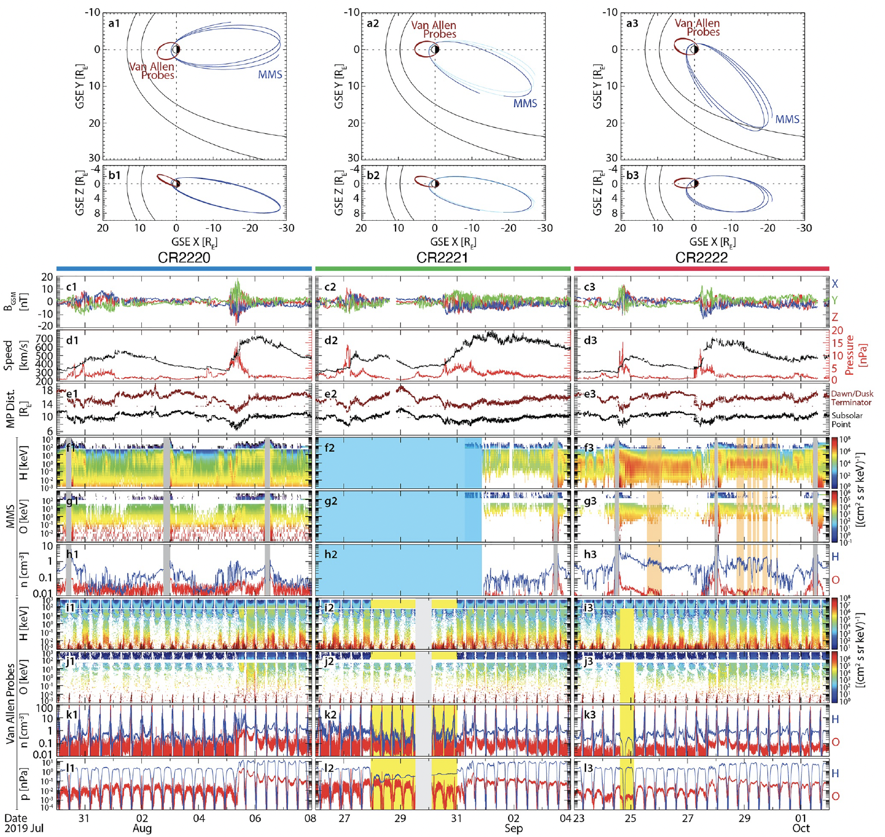
Magnetospheric Impacts
As CIRs can last for several solar rotations this can lead to repeated storms which can have additional effects due to pre-conditioning
The plasma sheet becomes mass loaded, which convects into the inner magnetosphere
Presence of oxygen ions in the plasmasheet is linked to different timescales of storm-time recovery via charge exchange lifetimes and impacts on the instabilities that can lead to substorms, like the tearing instability.
Preconditioning of seed particles enable enhanced acceleration during the main CIR through local stochastic acceleration of the seed population by chorus emissions.

Slide 10
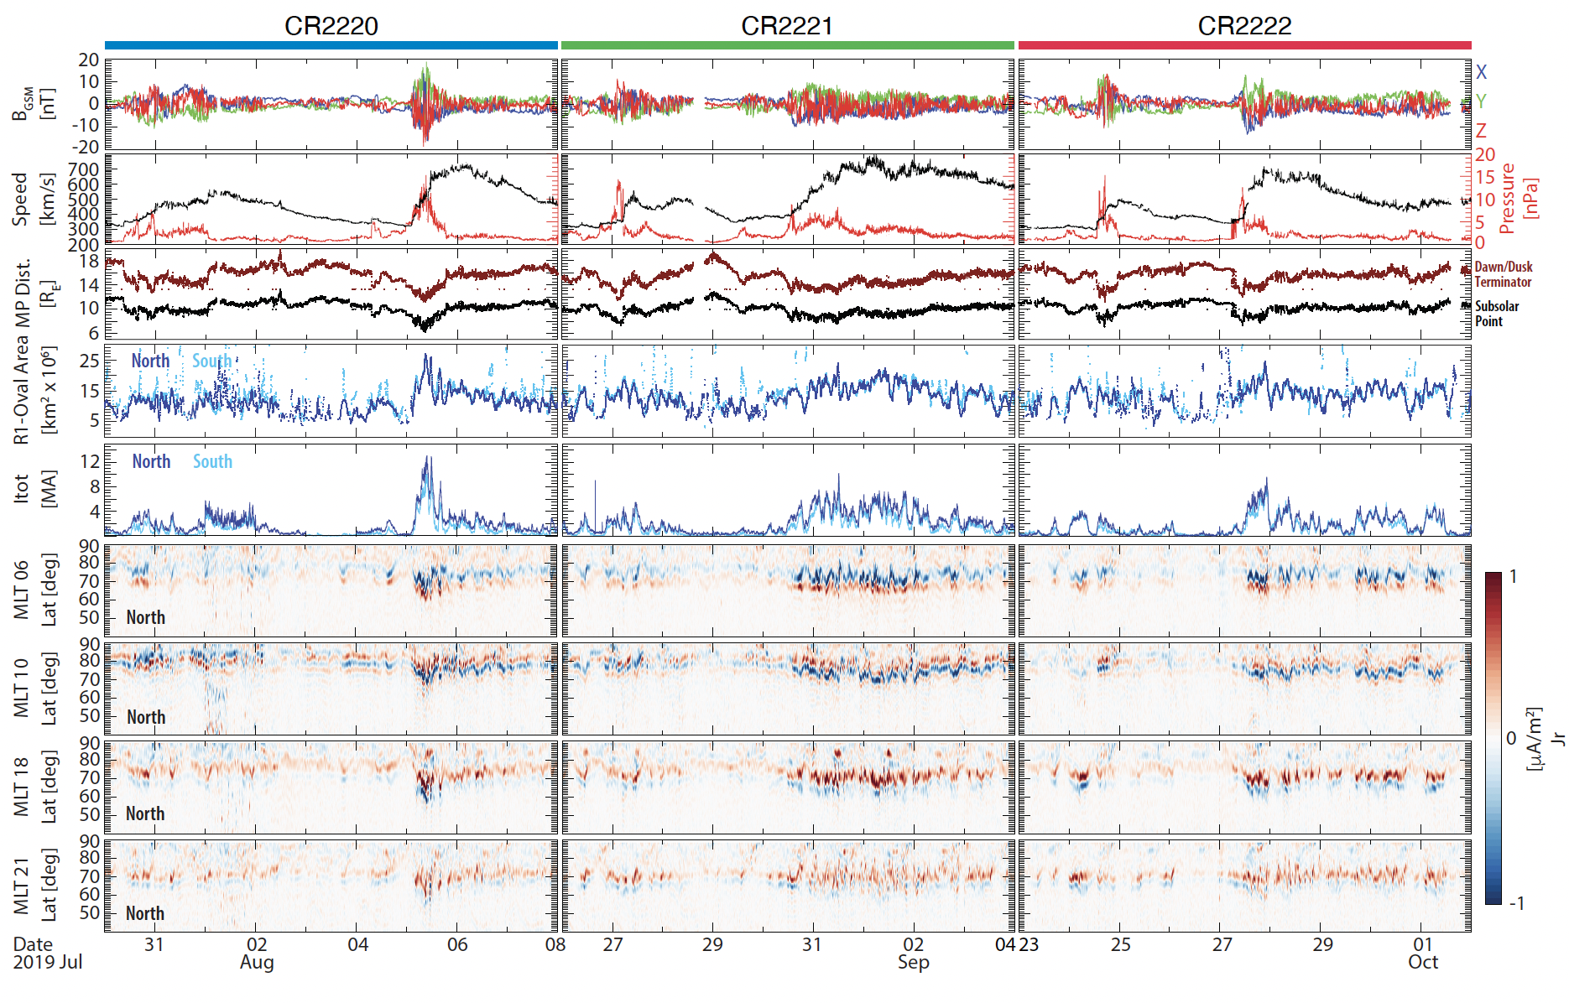
Magnetospheric Impacts

Slide 11
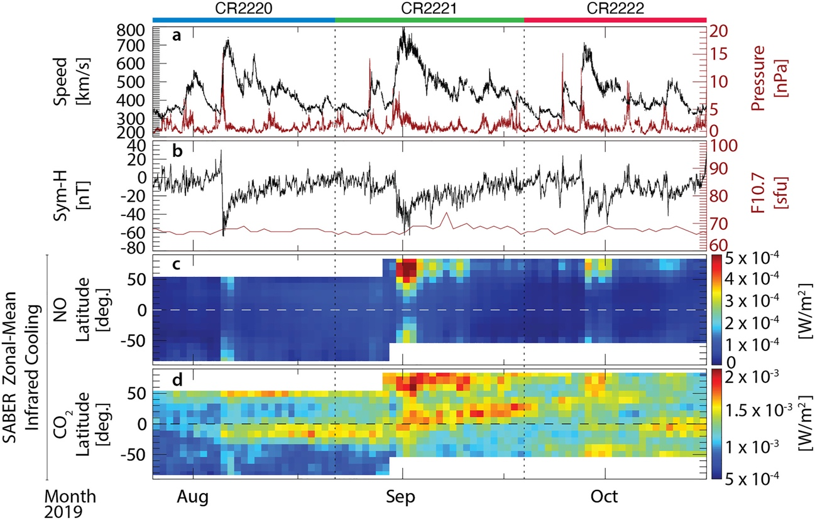
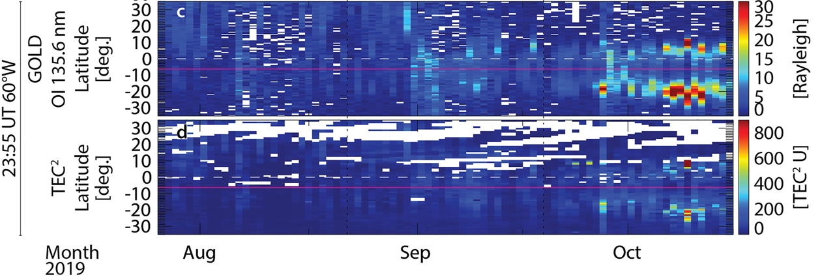
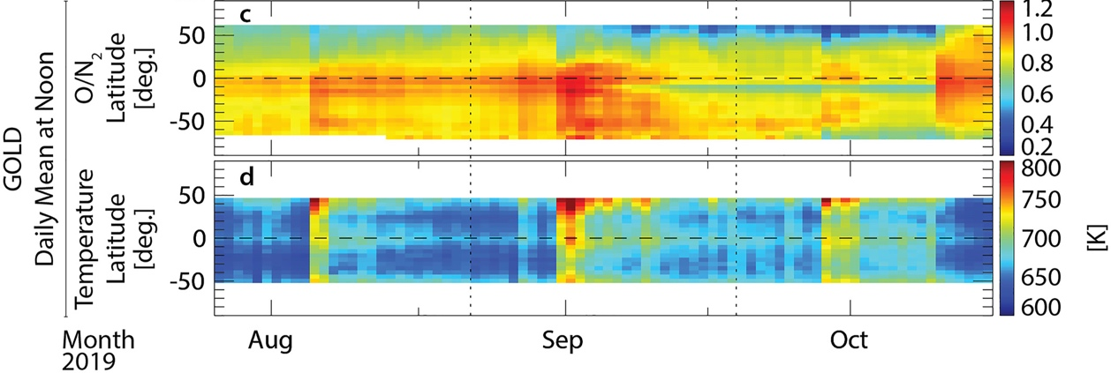
Ionospheric Impacts
All three CIRs drive ionospheric responses at mid-to-low latitudes, affecting thermospheric composition and neutral temperature disturbances globally.
Infrared cooling, inferred from the zonal-mean CO₂ and NO observations, is enhanced for all CIR passages
Auroral particle precipitation and Joule heating increase temperatures at different altitudes of the ionosphere and can lead to upwelling of plasma at high latitudes in response.
This upwelling has the net effect of decreasing the O/N₂ ratio at high latitudes.

Slide 12
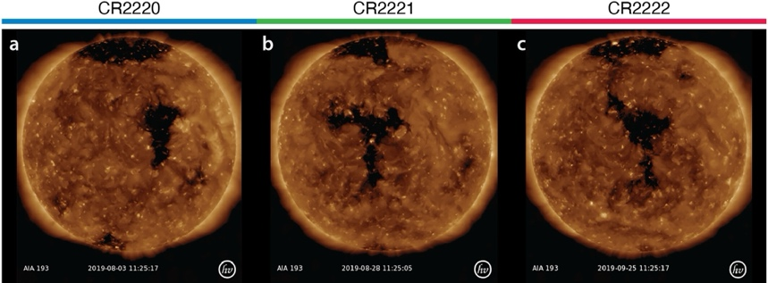
Summary
Assessing the response of the coupled M-ITM system can mean a lot of disparate observations:
The heliosphere is a highly coupled and dynamic system.
However, typical indices don’t capture all of the important storm-time phenomena in a one-to-one manner.
Storm-time phenomena in the magnetosphere, ionosphere, and upper atmosphere occur on various timescales, and impact different altitudes and latitudes.
Along with near-term upstream conditions, history of the system can influence response.
The recurring solar wind high-speed stream structure in 2019 drove very different storm-time responses that are not well captured by activity indices, like the radiation belt enhancements.
This likely points to pre-conditioning of the magnetospheric and ionospheric systems playing a large role in the evolution of a storm.
Sun
OMNI
Solar Wind & IMF
Interplanetary Space
Ring Current Index
Magnetosphere
Radiation Belt Electrons
Van Allen Probes
AMPERE
Polar Cap Field-Aligned Currents
Ionosphere & Upper Atmosphere
Thermospheric Neutral Composition
GOLD Daily Mean Ave. at Noon

